Slide 1
Brand Playbook
1.0 – Latest update – September 2022
CONFIDENTIAL – FOR INTERNAL USE ONLY

Slide 2
Content
BRAND FOUNDATIONS
Brand Descriptor
Brand Mission
Brand Vision
Brand Pyramid
Brand Essence & Personality
Positioning
Brand Promise
Brand Narrative
Values
Audience, Target Personas, Purchase Barriers
Competitors
COMMUNICATIONS STRATEGY
Communications Objectives
Consideration Loop/Attract Model
Content Pillars
Communication & Messaging Hierarchy
Features and Benefits
Target Decision-Markers
Brand Facets
Role of Xeim
Tone of Voice
Copy Guidance
Elevator Pitch
Visual Identity Overview
APPENDIX

Slide 3


Brand foundations

Slide 4
Your marketing experts

Slide 5
1. Descriptor
WHAT IS IT?
DEFINITION
The simplest complete description of what the brand is.
It must be inclusive (include all key attributes) and exclusive (could not be anything else).
It must answer the question: what is it?
It is NOT designed to be copy, but to form a basis of consensus about what a brand or product is and isn’t.
“ReallyB2B is the award-winning
B2B marketing solutions agency - blending emotional understanding and extensive marketing expertise to uncover insights, create engaging content, and help customers grow with results-driven campaigns”
Notes:
ReallyB2B is a leading B2B marketing solutions agency specialising in insight, lead gen and account based marketing
Is the emotionally intelligent B2B agency
The end to end B2B and lead gen experts, backed by intelligent insights
The experts in lead generation backed by insight led data
RB2B is the end to end marekting solutions agency for B2B and lead generation backed by intelligent insights
ReallyB2B is a end to end marekting solutions agency focused on lead generation, and backed by intelligent insights and award winning creative content
Customer centric

Slide 6
2. Brand Mission
WHY ARE WE HERE?
DEFINITION
Why the brand is there.
Our higher purpose. What drives what we do, beyond money.
It should serve as a filter to separate what is important from what is not, and inspire and direct the organisation.
“Helping brands to improve their understanding of the B2B market and become better connected with their audiences - to maximise sales opportunities & achieve business growth”
Notes:
Its not able the channel – we understand your customers
Winning your next big client
Focus on pain points of decision markets – not just selling a product
Audience – discovery
That’s why we care

Slide 7
3. Brand Vision
WHERE WE WILL BE AND
HOW WE WILL GET THERE?
DEFINITION
Where the business or brand aspires to be in the mid to long-term future.
It should be inspirational and aspirational.
“The go-to B2B marketing experts!
Trusted by brands to uncover insights, create award-winning campaigns, and accelerate business growth”

Slide 8
3. Descriptor (continued)
Services - What does ReallyB2B do?
Our hero services
STRATEGY & RESEARCH
CONTENT & CREATIVE
DATA & DELIVERY
Research & expert interviews
Content strategy
Data management,
insights & licensing
Audience identification,
profiling and segmentation
Big Idea
Multi-channel campaign delivery
Customer journey mapping
Copy writing & messaging
Sales enablement/enhancement
Channel strategy & planning
Content creation
Campaign management, optimisation & reporting

Slide 9


4. Brand Pyramid
Brand essence & personality
YOUR MARKETING EXPERTS
THE B2B marketing experts, helping brands better connect to their audience.
Essence
Expert, accountable, driven, principled
Values
Informed & enabled, impressed, supported & reassured,
Inspired and challenged.
Emotional Benefits
Functional
Benefits
Better business results - growth.
‘Winning your next key account’
Increased brand awareness and consideration.
Lead-gen, demand gen, ABM knowledge. Expertise, approaches & methodologies.
Insights, research, data & data analysis, strategy, planning, creative, content,
development and marketing.
Award-winning results.
Backed by Xeim - Excellence in Marketing – access to a wide range of tools & services.
Features
Notes:
What are the key features of the business?
Features - Tangible elements of the business (concrete / physical elements)
Functional benefits – using / consuming products / services (practical)
Emotional benefits – doing good / fixing a problem / feeling (emotive)

Slide 10
5. Brand Essence & Personality
Essence – The B2B marketing experts, helping brands achieve their goals and better connect to their audience.
ReallyB2B…
IS
Passionate
Trusted & approachable
Collaborative & flexible
Intelligent and knowledgeable
Frank & honest – not afraid to tell a client what they really need
Creative
Fun and playful – family feel
Pragmatic
Principled and ethical
ISN’T
Boring or stuffy
Cold or exclusive
Traditional or dull
Too clever or complex - no jargon
Patronising
London-centric
Unscrupulous
Self-indulgent

Slide 11

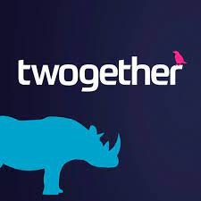



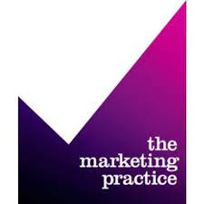




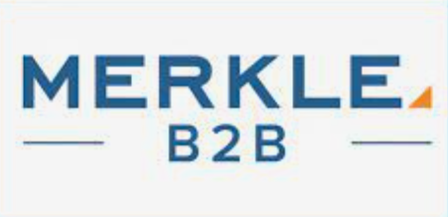














6. Positioning
ReallyB2B is an end-to-end B2B marketing agency with a raft of knowledge across B2B marketing approaches, making us a dynamic player in this market.
MASS MARKET APPROACH
END TO END SERVICE
SINGLE SPECIALIST
HYPER TARGETED APPROACH
Notes:
I think we need to consider replacing the purple. Where it was once our key differentiator, it’s now just become marketplace camouflage.

Slide 12
7. Brand Promise
ReallyB2B PROMISES TO…
DEFINITION
A strong brand promise connects purpose, positioning, strategy, people and customer experience.
It is the manifestation of what the brand stands for in a way that customers can understand and differentiates itself from its competitors.
“With expertise and a relentless focus on creatively igniting conversations between you and your audience, we passionately support and empower your team to achieve their goals”
Notes:
What does our audience want from us

Slide 13
8. Brand Narrative
“Having been established in 2006 to support a successful telemarketing agency (MarketMakers), we have since spent 15+ years refining our strategies and specialisations to build the industry’s strongest and most capable team of B2B marketing experts.
Whether prospects are looking to identify new audiences, ignite conversations with new or existing customers, or highly focus their efforts in an ABM campaign, we have the best people for the job.
By blending emotional understanding and extensive expertise, we’ve not only supported and empowered global brands to accelerate their business growth, but we’ve also retained their partnerships thanks to our award-winning capabilities in strategy & research, content & creative, and data & delivery. ReallyB2B is the award-winning B2B marketing solutions agency.”
DEFINITION
The story behind the brand. Why the brand exists, where it came from, and where it is going.
A narrative makes the brand accessible and personable.
It should have an emotional Impact – people should feel better connected with the brand knowing where it came from.

Slide 14




9. Our Values
Expert, accountable, driven and dedicated
EXPERT
Knowledgeable & experienced, we make our clients feel confident and reassured.
ACCOUNTABLE
Reliable, consistent and proactive, we always get the job done on time.
DRIVEN
Passionate and motivated, we are focused on delivering top-quality work.
PRINCIPLED
Honest & frank, we fight for what's right. We are an extension of our clients’ teams.

Slide 15
10. Our audience
‘Perfect Prospect’ Criteria
Who do we want to talk to?
£10M+ in turnover
Large businesses, with UK head office or strong UK presence preferable
Focus on English-speaking regions
Compelling product or service offering. Wide client target base to ensure the prospect is scalable & could provide longevity of work
Approx. £1M+ marketing spend
£100k+ agency fee (£5k pm minimum across depts per year)
Value to prospect: £10K life time value per client
Must also support our ‘fame, fortune, fun’ purpose
Notes:
Where the client has a compelling product or service offering – to fit a wide customer base
Ideal industries [not exclusive]: Automotive /fleet brands, energy, marketing services / business support, tech, lifestyle, FMCG, brands with a suitability focus, hospitality, construction, plumbing and electricals.

Slide 16
10. Our audience – Prospect categorisation
Who do we want to talk to?
Before prospects can be categorised so we can focus our time & energy, they must fit our ‘Perfect Prospect’ criteria first.
OUTBOUND
Platinum
Outbound - Prospects we want to proactively approach
Must be ‘perfect prospects’ and fulfil ‘gold’ criteria & show intent
Quality leads from Xeim – who are interested in ABM
Gold
B2B2C brands – with a good understanding of marketing (i.e. Nespresso).
High brand awareness
Size & scale of clients audience - wide client base
Proportionate levels of TM and media to aid margin mix not dilute
From industries we have expertise in
From industries of interest – i.e. Lifestyle, FMCG
Silver
B2B2C or B2B brands
Mid to high brand awareness
Size & scale of clients audience – mid to wide client base
Proportionate levels of TM and media to aid margin mix not dilute
From industries we have expertise in
Bronze
B2B brands
Size & scale of clients audience – mid to niche client base: Smaller audience, generating minor campaigns or one-off projects.
Proportionate levels of TM and media to aid margin mix not dilute
Unrelated industries to ReallyB2B expertise or interest
CAUTION
Industries:
These industries are heavily regulated and often take more time to service thus they can become margin dilutive if we do not allocate additional time to allow for more rounds of amends and approvals:
Finance
Insurance
Legal
Healthcare
Regions:
Caution should be used for work across multiple regions & non-English speaking countries, due to challenges in translations, GDPR laws and localisation
Telemarketing:
Caution should be used for prospect who require high levels of telemarketing activity as this carries a 10% margin and is margin dilutive of our total business
INBOUND

Slide 17
10. Our audience - Target persona
Who do we want to talk to?
Our key focus should be ‘gold’ perfect prospects, those prospects who will become the most interesting and lucrative clients, so its important to understand & recognise their motivations and attitudes.
REALLYB2B CORPORATE TARGET | MOTIVATED TO DO WHAT? | INFLUENCED BY | ATTITUDE TOWARDS AGENCIES | REASONS TO BELIEVE IN REALLYB2B
‘Gold’: Mid-sized B2B2C brands with t/o £10m+ | Drive business growth Learn more about their prospects – research & audience understanding Define who to target Create a strategy to target key accounts Develop brilliant campaigns Looking for high ROI | Peers/networking Publications: Marketing Week Drum Campaign ‘Followed on’ LinkedIn & Twitter Industry events | See agencies as providers of outside added-value thinking that they don’t have internally Access to systems & processes unavailable within their organisation Proactively seek and manage agency partners | Our experience Content & creative knowhow Big client brand experience – client retention Team knowledge & expertise – an extension of our clients team Business results/case studies Client review Award-winning agency

Slide 18
10. Our audience - Purchase barriers
Barriers our prospects may face when considering ReallyB2B
 | AWARENESS/ DISCOVERY | RELEVANCE | CONSIDERATION | BELIEVABILITY | NECESSITY | RELATIONSHIP
BARRIER | “I’ve never heard of ReallyB2B” | “I’m not sure they have the expertise I need! They’re not a big London agency!” | “I already work with a number of agencies, why should I consider using ReallyB2B?” | “I don’t know if ReallyB2B is capable? They are only a small agency. I don’t think they work on any big brands” | “I don’t understand the value of the services ReallyB2B provides!” “We just need some lead gen, why spend more on ABM or other lead generation activities?’ | “Are ReallyB2B an agency I could/want to work with?”
HOW TO ADDRESS | Drive awareness of ReallyB2B to get into their consideration set because they understand Really is THE B2B marketing solutions agency. | Reinforce that other notable brands work with ReallyB2B. Demonstrate our range of services. Explain that London agencies can lack agility and broader market vision. | Show expertise and wealth of knowledge through case studies, backed by award wins. | Give reassurance that ReallyB2B is the right agency for the job. Demonstrate that smaller agencies can be more nimble & effective – leverage Xeim credentials to build trust & reassurance. Exhibit range of brands ReallyB2B works with. | Help prospects see the bigger picture of how ABM/lead gen works and how it could transform their new business pipeline. Discuss the value of igniting conversations with new and existing audiences. | Use ratings & reviews to build reassurance.

Slide 19
11. Competitor overview
See appendix for more details on the ReallyB2B competitor set
PRIMARY
SECONDARY
TERTIARY

Slide 20
Communications
strategy

Slide 21
1. Communications objectives
1. Communications objectives
Catch
Connect
Close
Build awareness
of the agency
Share our expertise & experience
Build consideration – ensure we are top of mind when our prospect is ready to buy

Slide 22
2. ReallyB2B’s consideration loop
Building an attract model
Attract
Engage
Delight
New clients
Consider
Current clients
Not
Aware
Catch
Purchase
Connect
Close
Lapsed clients
Aware
Engaged

Slide 23
3. Content pillars
Our content pillars should act as our guiding light when creating content plans and helping us determine what we push out to our audience to ensure we stay relevant.
B2B
Clients & our work
Creative Innovation
Culture & people
All about the industry:
Thought leadership
Effectiveness
Best practices
Category insights & trends
Blogs
B2B news
Showcasing our clients, our work and our brand:
Awards
Case studies
Client meetings
New business wins
Featuring at events
Demonstrating how we use insights & creative:
Research & data
Our methodology & thinking
Intelligent insights
Big ideas
Creative content
Building an employer brand:
Attending events
Awards
Out & about
Socials/team meetings
Internal awards
Charity

Slide 24
4. Communication hierarchy guide - overview
(Guidance - not actual copy)
WHAT IS REALLYB2B
ReallyB2B is the award-winning B2B marketing solutions agency
- blending emotional understanding and extensive marketing expertise to uncover insights,
create engaging content, and help customers grow with results-driven campaigns.
COMMUNICATION PILLARS
B2B
Clients & our work
Creative innovation
Culture & people
HERO SERVICES
Strategy & research
Content & creative
Data & delivery
KEY OUTCOMES
Results
(i.e. audience identification, improved strategy etc)
Business Growth
REASONS TO BELIEVE
People, experience across industries. Award winning.
Lead gen, demand gen & ABM knowledge. Research, insights & data knowhow.
High performance, high calibre team. Content & creative expertise.
Access to Xeim tools and services at great prices – subscriptions, events, sponsorships, training etc
REASSURANCE
Our heritage & experience, steady organic growth,
Trusted, diversity of thinking.
Big brand clients, client retention, case studies & reviews.
PAYOFF
Your Marketing Experts

Slide 25
5. Features and Benefits
ReallyB2B clients will buy into the agency because of its benefits, not its features.
Feature​ | Advantage​ | Benefit ​ (What’s in it for me?/So what?)​
B2B marketing experts | With a variety of marketing activities available and a range of agencies to choose from (some specialist and some generalist), you can rest assured that we have all the experts you need under one roof. | Confidence that your activity will generate the best results and you’ll prove your worth to the business.
Lead-gen, demand gen, ABM knowledge | Does your business need lead gen, demand gen or ABM? Do you need to source these activities from different places? At ReallyB2B, we have won awards for our campaigns in all these areas, so let us help you identify and implement the campaign that’s right for your needs. | A one-stop-shop so you can confidently and efficiently achieve your goals and targets.
Our expertise, approaches & methodologies | At ReallyB2B, we use best-practise techniques for every channel and every element of your campaigns. If we find new ways to generate better results, we are agile enough to change what we believe to be best practise. | Relax in the knowledge that ReallyB2B is not only doing exactly what you need, but they are doing it the right way too.
Strategic thinking & planning | We have spent 15+ years refining our strategies and specialisations to build the industry’s strongest and most capable team of experts. | Whatever your challenge and whatever your goals, you can rest assured that we will have experienced similar in the past and will know the best way to help you succeed.
Notes:
B2b marketing experts
Lead-gen, demand gen, ABM knowledge.
Expertise, approaches & methodologies.
Strategic thinking & planning
Intelligence audience insights
Creative content
Insights, research, data & data analysis, strategy, planning, creative, development and marketing.
Award winning results.
Backed by Xeim - excellence in marketing – access to a wide range of tools & services.

Slide 26
5. Features and Benefits (continued)
ReallyB2B clients will buy into the agency because of its benefits, not its features.
Feature​ | Advantage​ | Benefit ​ (What’s in it for me?/So what?)​
Intelligence audience insights | Successful marketing is about sending the right message to the right person at the right time, and this is only possible with the right information and insights – which we can uncover. | Make sure your budget is spent in the correct ways and in the right areas to generate maximum results and ROI.
Research, data & data analysis | Gathering data, mining insights and then putting these to good use is not something that’s easily achieved. But we have experts who can help you do just that. | Experience the confidence that comes with knowing your campaigns and activities are based on accurate numerical data and insights, analysed by experts.
Creative content | Your product/service is useless if you can’t tell your audience about it in an engaging way. Luckily, we have an award-winning creative team who can turn your message into high-impact and memorable content. | Why choose a lead gen agency for one task and a creative agency for another? Experience the efficiency of an aligned agency team, and enjoy the lasting impression good content can leave on the minds of your prospects.
Award-winning results | Since 2013, we have won over 20 industry awards, in highly contested categories – so you know we are good. | Experience the pride that comes with knowing you are working with some of the most proven experts in the industry.
Backed by Xeim - excellence in marketing | As part of the Xeim Group, we also provide our clients with access to a wide range of tools & services from other industry-leading brands. | Rest assured that when you partner with ReallyB2B, you are also opening the door to a wealth of specialists in a variety of areas and leading businesses.
Notes:
B2b marketing experts
Lead-gen, demand gen, ABM knowledge.
Expertise, approaches & methodologies.
Strategic thinking & planning
Intelligence audience insights
Creative content
Insights, research, data & data analysis, strategy, planning, creative, development and marketing.
Award winning results.
Backed by Xeim - excellence in marketing – access to a wide range of tools & services.

Slide 27
6. Our audience
Target decision-makers
Why?
Using the principles of DiSC profiling, we can place our decision-makers into roughly 1 of 4 personality groups.
This enables us to better understand their buying behaviours on a personal level, and adapt our marketing messages and activities to drive improved engagement.
Marketing Directors
Sales Directors
Managing Directors
Procurement (influencers)
THE TARGET DECISION-MAKERS FOR REALLYB2B ARE…

Slide 28
6. Our audience
Target decision-makers
Sales and Marketing
SELLING TO THIS GROUP…
When selling to this impulsive group, we need to secure their commitment to buy or potentially lose the sale – this means we should implement sales strategies to reflect this.
Call to actions should be strong, and reinforced with call to action buttons that send the prospect directly to a landing page where they can immediately make a purchase or speak to a sales person.
Sales and marketing directors typically fall into I-profile types.
I-styles prefer light and airy conversation, so drop the conventional business tone, and instead write with a positive, fun and chatty style.
Focus on how your product or service will effect the I-style’s experience and emotions. Fundamentally, how will it make other people view them?
When writing, be a little more informal. Make a few jokes, and don’t get bogged down in the dull and drab details.

Slide 29
6. Our audience - Target decision-makers
Messaging hierarchy for Marketing Director/Manager
Pain point​ | Response
Delivering ROI is key to securing future budget. How do I measure effectively and maintain KPIs? I must deliver all the business’ marketing needs effectively and within the deadlines. | Does your business need lead gen, demand gen or ABM? Do you need to source these activities from different places? At ReallyB2B, we are a one stop shop, so you can confidently and efficiently achieve your goals and targets, whatever they are. Our experts make sure your budget is spent in the correct ways and in the right areas to generate maximum results and ROI – in the timeframes you require.
I am experiencing instability in our marketplace. Restructuring within prospects’ & clients’ businesses is making marketing funnels more complex/slower. I’m having to start over/pause discussions etc. | With expertise and a relentless focus on creatively igniting conversations between you and your audience, we passionately support and empower your team to achieve their goals. Experience the efficiency of an aligned agency team, and enjoy the lasting impression good content can leave on the minds of your prospects.
Since the pandemic, building and retaining talented marketing teams has become more challenging - impacting results. | We passionately support and empower your team to achieve their goals via our expertise and a relentless focus on creatively igniting conversations between you and your audience. We work as an extension of your existing team, so you can relax in the knowledge that ReallyB2B is not only doing exactly what you need, but we are doing it the best-practise way too.
I have the challenge of stakeholder management i.e., sitting at C-suite/senior leadership level and balancing wider business objectives with more tactical marketing goals. | Since 2013, we have won over 20 industry awards, in highly contested categories – so you know we are good. Not only can you experience the pride that comes with knowing you are working with some of the most proven experts in the industry, but you’ll be empowered to prove your worth to the business.

Slide 30
6. Our audience - Target decision-makers
Messaging hierarchy for Sales Director/Manager
Pain point​ | Response
I need to achieve sales targets, desired market share and business growth – in tight timelines. | With expertise and a relentless focus on creatively igniting conversations between you and your audience, we passionately support and empower your team to achieve their goals. Our experts make sure your budget is spent in the correct ways and in the right areas to generate maximum results and ROI – in the timeframes you require.
I have trouble using data and analysis to diagnose problems in the sales process and identifying leaks in my sales pipeline. | Gathering data, mining insights and then putting these to good use is not something that’s easily achieved. But we have experts who can help you do just that. Experience the confidence that comes with knowing your activities and processes are based on accurate numerical data and insights, analysed by experts and effectively used in pursuit of your goals and objectives.
I need to keep up with fast-moving digital innovation. Sales teams can often be slower to adapt to change. My role increasingly requires larger components of online, social media and thought leadership content. I must drive tangible results via these channels. | Your product/service is useless if you can’t tell your audience about it via their preferred channels. Luckily, we have an award-winning creative team who can turn your message into high-impact and memorable content. Experience the efficiency of an aligned agency team, and enjoy the lasting impression good content can leave on the minds of your prospects.
Since the pandemic, recruiting, building and retaining a talented sales team has become difficult - impacting results. | We passionately support and empower your team to achieve their goals via our expertise and a relentless focus on creatively igniting conversations between you and your audience. We work as an extension of your existing team, so you can relax in the knowledge that ReallyB2B is not only doing exactly what you need, but we are doing it the best-practise way too.
I am experiencing instability in our marketplace. Restructuring within prospects’ & clients’ businesses is making sales processes more complex/slower. I’m having to start over/pause discussions etc. | At ReallyB2B, we are experts in creatively igniting conversations between you and your audience. What’s more, we are trusted by global brands to uncover insights, create award-winning campaigns, and maximise sales opportunities – and we can do the same for you too.

Slide 31
Managing Directors
SELLING TO THIS GROUP…
Given their need to feel in control, D profiles will not respond well to being spoon-fed content. Instead, it’s vitally important to front-load campaign content and house all of this on a central hub or concise deck – with the contact details of a sales expert.
In doing this, we are ultimately empowering Ds to not only self-serve, but also to choose the content and subject matters that they are directly interested in. By placing the ‘power’ in their hands, we give them an opportunity to exert their strength, will, and control. Ultimately, we don’t want to get in the way of the sale.
6. Our audience
Target decision-makers
Managing Directors are the epitome of the D-profile.
Concise, fact-driven copy is the best way to engage D-styles. Write powerfully and with confidence.
Show a willingness to take risks, be decisive, and put an emphasis on achievement and status.
Use hard-hitting top-level statistics, and a no-nonsense approach. This means avoiding superfluous and flowery language – in short, get to the point.

Slide 32
6. Our audience - Target decision-makers
Messaging hierarchy for Managing Director
Pain point​ | Response
I need business growth | Does your business need lead gen, demand gen or ABM? Do you need to source these activities from different places? At ReallyB2B, we have won awards for our campaigns in all these areas, so let us help you identify and implement the campaign that’s right for your needs. We blend emotional understanding and extensive expertise to uncover insights, create engaging content, and help you ignite conversations between you and your audience.
I’m under pressure to deliver profitable business | We help brands to improve their understanding of the B2B market and become better connected with their audiences - to maximise sales opportunities & achieve business growth. What’s more, Our experts make sure your budget is spent in the correct ways and in the right areas to generate maximum results and ROI.
I am short on time. I can’t be too involved in the day-to-day operation of the business, so I need to know things are working correctly without my input. | We passionately support and empower your team to achieve their goals via our expertise. We work as an extension of your existing team, so you can relax in the knowledge that ReallyB2B is not only doing exactly what you need, but we are doing it the best-practise way too.

Slide 33
6. Our audience
Target decision-makers
Procurement
SELLING TO THIS GROUP…
We must be patient, consistent and prepared with facts and information in order to close the deal with C-styles.
This means frequent contact via email, delivering regular informative and engaging pieces of long-form content. We should make it clear that we’re always available to provide further details, and this should be easily accessible via phone, email or the click of a button in an HTML.
A vital component of communications with C profiles is support.
Procurement roles typically fall within the C-profile.
When writing for C-styles, be precise, factual and detailed. Avoid criticism, and instead present a logical and clear argument.
Don’t write in an overly emotive style. Instead, write technically. Use industry-relevant language. Show that you play by the rules, and wherever possible, reinforce your offering with facts, statistics, professional testimony, and expert endorsements. What’s important is thoroughness and patience. Leave no stone unturned. Anticipate and answer all of their concerns.

Slide 34
6. Our audience - Target decision-makers
Messaging hierarchy for Procurement (influencers)
Pain point​ | Response
I need suppliers that are able to help us reduce costs, improve production processes, and outperform the competition by rapidly responding to customers’ requirements. | Does your business need lead gen, demand gen or ABM? Do you need to source these activities from different places? At ReallyB2B, we are a one stop shop, so you can confidently and efficiently achieve your goals and targets, whatever they are. Our experts make sure your budget is spent in the correct ways and in the right areas to generate maximum results and ROI.
I need to ensure all of my suppliers are able to meet our compliance needs. | By blending emotional understanding and extensive expertise, we’ve not only supported and empowered global brands to accelerate their business growth, but we’ve also retained their partnerships thanks to our award-winning capabilities in strategy & research, content & creative, and data & delivery. Whatever your challenge and whatever your goals, you can rest assured that we will have experienced similar in the past and will know the best way to help you succeed.
I need to ensure the financial security of our suppliers. | ReallyB2B is part of the Xeim Group, the marketing arm of Centaur Media. This division of the business also includes well-known and respected brands such as Marketing Week, Econsultancy, Creative Review and the Festival of Marketing. So whilst you are partnering with the award-winning B2B marketing solutions agency, you can rest assured that we are also backed by a large-scale, successful media organisation.
I need a seamless integration of new technologies and suppliers. | We have spent 15+ years refining our strategies and specialisations to build the industry’s strongest and most capable team of experts. With global brands making up our client list, there are very few (if any) scenarios that we have not only experienced, but also created innovative solutions for. The result is that when you partner with ReallyB2B, you can rest assured that our experts will quickly get to work as an extension of your existing team, and help you efficiently achieve your goals.

Slide 35
7. Brand Facets
How we should be seen by clients, potential employees and the industry
Creative, challenging, supportive, diversity of thinking, flexible and a focus on work-life balance, fun,
family vibe
Opportunities for growth
Great L&D options
Camaraderie
The go-to B2B marketing experts!
Trusted by brands to uncover insights, create award-winning campaigns, and accelerate business growth
EMPLOYEE
CLIENT
AGENCY WORLD
ReallyB2B is the award-winning,
B2B marketing solutions agency
- blending emotional understanding and extensive marketing expertise to uncover insights, create engaging content, and help customers grow with results-driven campaigns.

Slide 36
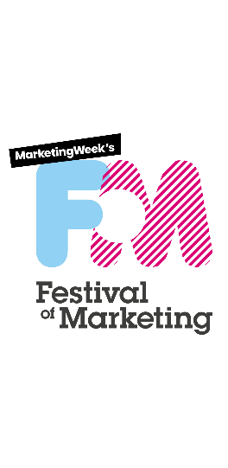








8. Role of Xeim
Xeim is Really’s icing on the cake – access to a wide suite of tools & services dedicated to excellence in marketing.
ReallyB2B is proud to be part of Xeim, a family of industry-leading businesses dedicated to excellence in digital, marketing & creativity.
Unrivalled authority in marketing
Industry-leading live content
MBA-level marketing training
The award-winning B2B marketing solutions agency
Digital marketing & ecommerce excellence
Influencer marketing data tool
Champions of creativity
The home of world-class design
Agency partnership & strategic consultancy

Slide 37
9. Tone Of Voice & Values
Written tone of voice is the personality of our brand, expressed through the written word.
If our copy has a single, recognisable tone of voice, it can make us easier to understand.
We are...
Specialists | Trusted | Passionate | Partners
We behave in a manner that is…
EXPERT | ACCOUNTABLE | DRIVEN | PRINCIPLED
Experienced Influential Informed Considered Authoritative | Reliable Diligent Proactive Consistent We get the job done | Ambitious Motivated Focused but curious We care Creative & spirited | Honest & frank - Fight for what's right Customer centric Insight led & resourceful Solution & results oriented An extension of our clients’ teams
Therefore our voice will always sound…
KNOWLEDGEABLE | AUTHENTIC | ENERGETIC | CONSIDERED
So we make people feel…
Reassured Confident | Enabled Supported | Energised Engaged | Inspired Positive

Slide 38
9. Tone Of Voice & Values - Expert
Written tone of voice is the personality of our brand, expressed through the written word. If our copy has a single, recognisable tone of voice, it can make us easier to understand.
We are…
Specialist
We behave in a manner that is…
Expert
- Experienced
- Influential
- Informed
- Considered
- Authoritative
Therefore our voice will always sound…
Knowledgeable
So we make people feel…
Reassured
Confident
An example of a Expert tone of voice…
“Having worked with numerous global brands and achieved award-winning results from our campaigns, we know that account based marketing (ABM) generates around 70% better results than traditional marketing. With this in mind, if you are aren’t already doing ABM, then we advise you consider investing in this methodology before the end of the year.”
An example of an Expert employee…
Speaks confidently about marketing
Can back up opinions with numerical facts
Recalls previous experiences to add value
Doesn’t react ‘too’ quickly
Has a deep understanding of what they are talking about

Slide 39
9. Tone Of Voice & Values – Expert
An examination of the Expert tone of voice
Informed
Considered
Experienced
“Having worked with numerous global brands and achieved award-winning results from our campaigns, we know that account based marketing (ABM) generates around 70% better results than traditional marketing, With this in mind, if you are aren’t already doing ABM, then we advise you consider investing in this methodology before the end of the year.”
Influential
Authoritative

Slide 40
9. Tone Of Voice & Values - Accountable
Written tone of voice is the personality of our brand, expressed through the written word.
If our copy has a single, recognisable tone of voice, it can make us easier to understand.
We are…
Trusted
We behave in a manner that is…
Accountable
- Reliable
- Diligent
- Proactive
- Consistent
- We get the job done
Therefore our voice will always sound…
Authentic
So we make people feel…
Enabled
Supported
An example of an Accountable tone of voice…
“Whilst LinkedIn has proved to be a powerful tool for B2B marketing, we don’t think this is right for your campaign. We’ve analysed the numbers and we believe that because your offering is niche, we think you would benefit from account based marketing activity. Whilst the time and resources needed for ABM will be greater, we can fully support you in this pursuit.”
An example of an Accountable employee…
Speaks to clients in a matter-of-fact and honest way
Doesn’t just highlight issues, but presents solutions too
Stays up to date with industry developments and shares these with clients
Pulls up their sleeves and gets involved when needed
Keeps clients informed and up to date (whether good or bad)

Slide 41
9. Tone Of Voice & Values – Accountable
An examination of the Accountable tone of voice
Diligent
Proactive
Reliable
“Whilst LinkedIn has proved to be a powerful tool for B2B marketing, we don’t think this is right for your campaign. We’ve analysed the numbers and we believe that because your offering is niche, we think you would benefit from account based marketing activity. Whilst the time and resources needed for ABM will be greater, we can fully support you in this pursuit.”
Consistent
We get the job done

Slide 42
9. Tone Of Voice & Values - Driven
Written tone of voice is the personality of our brand, expressed through the written word.
If our copy has a single, recognisable tone of voice, it can make us easier to understand.
We are…
Passionate
We behave in a manner that is…
Driven
- Ambitious
- Motivated
- Focused but curious
- We care
- Creative & spirited
Therefore our voice will always sound…
Energetic
So we make people feel…
Energised
Engaged
An example of a Driven tone of voice…
“Content marketing has a proven track record of generating results, but we take it to the next level. By carefully crafting a digital experience for audiences, we can surprise and delight, engage and convert – helping you achieve never-before-seen clickthrough rates. Our experts love what they do and they can’t wait to get started on your next industry-leading campaign.”
An example of a Driven employee…
Constantly looks for the next ‘big thing’ in marketing
Is enthused by great results and client happiness
Focuses on L&D and finding new ways to do things
Loves to find creative solutions to problems and think outside the box
Takes great joy in marketing and enjoys sharing information with colleagues

Slide 43
9. Tone Of Voice & Values - Driven
An examination of the Driven tone of voice
Motivated
Focused but curious
Ambitious
“Content marketing has a proven track record of generating results, but we take it to the next level. By carefully crafting a digital experience for audiences, we can surprise and delight, engage and convert – helping you achieve never-before-seen clickthrough rates. Our experts love what they do and they can’t wait to get started on your next industry-leading campaign.”
Creative and spirited
We care

Slide 44
9. Tone Of Voice & Values – Principled
Written tone of voice is the personality of our brand, expressed through the written word.
If our copy has a single, recognisable tone of voice, it can make us easier to understand.
We are…
Partners
We behave in a manner that is…
Principled
- Honest & frank - fight for what's right
- Customer centric
- Insight led & resourceful
- Solution & results oriented
- An extension of our client’s team
Therefore our voice will always sound…
Considered
So we make people feel…
Inspired
Positive
An example of a Principled tone of voice…
“Our experts work as an extension of your team, and that means we care just as much about your budgets and results as you do. With the budget you currently have, we don’t believe 1-to-1 ABM is for you. Instead, we suggest you expand your audience and implement a 1-to-few strategy. We will of course, help you with strategy, planning and implementation to ensure you achieve the results you are looking for. This will be a much better approach for your business.”
An example of a Principled employee…
Says “no” when necessary and can back up their opinion
Cares exclusively about helping clients reach their goals
Considers all data and options before making a decision
Will never simply appease clients for an easier life
Will enter into open conversations with clients and planners to ensure all decisions are grounded in truth and reality

Slide 45
9. Tone Of Voice & Values - Principled
An examination of the Principled tone of voice
Customer centric
And extension of client’s team
Insight led
“Our experts work as an extension of your team, and that means we care just as much about your budgets and results as you do. With the budget you currently have, we don’t believe 1-to-1 ABM is for you. Instead, we suggest you expand your audience and implement a 1-to-few strategy. We will of course, help you with strategy, planning and implementation to ensure you achieve the results you are looking for. This will be a much better approach for your business.”
Solutions/results orientated
Honest and frank

Slide 46
10. Copy guidance
How to apply - what/why/how/for who?
What is ReallyB2B? - Descriptor
ReallyB2B is the award-winning B2B marketing solutions agency.
Who for? – Client/prospect
We help large businesses that are looking to better understand, connect and converse with both new and existing B2B customers in the pursuit of business growth.
Why are we here? – Mission/Purpose
To help brands improve their understanding of the B2B market and become better connected with their audiences - to maximise sales opportunities & achieve business growth.
How do we do it?
By blending emotional understanding and extensive expertise, with award-winning capabilities in strategy & research, content & creative, and data & delivery, we create results-driven campaigns that help clients maximise sales opportunities & achieve business growth.
Payoff
Your Marketing Experts

Slide 47
11. Elevator pitch
How to apply:
This script is designed specifically to be the spoken word. It should be used in scenarios where we have 30 seconds to introduce or describe ReallyB2B with accuracy. Examples of when it should be used are pitches, chance encounters with potential clients and at the start of interviews where we should use a consistent text to accurately and correctly describe ReallyB2B.
ReallyB2B – what do you do?
We are a team of award-winning B2B marketing solutions experts that help brands understand the B2B market and become better connected with their audiences - to maximise sales opportunities & achieve business growth.
Whether you’re looking to generate leads, create demand, or focus your attention in an ABM campaign, we have the knowledge and expertise in strategy & research, content & creative, and data & delivery, to help you achieve your goals.
How do you do that?
Our experts blend emotional understanding and extensive expertise to uncover insights, create engaging content, and help customers grow with results-driven campaigns. Our 20+ award wins over the past 15 years will give you the confidence that comes with knowing you are working with some of the most proven experts in the industry.

Slide 48
11. Elevator pitch (continued)
How to apply:
This script is designed specifically to be the spoken word. It should be used in scenarios where we have 30 seconds to introduce or describe ReallyB2B with accuracy. Examples of when it should be used are pitches, chance encounters with potential clients and at the start of interviews where we should use a consistent text to accurately and correctly describe ReallyB2B.
What are the benefits?
The one-stop-shop to achieve your marketing needs
Maximise your sales opportunities
Ignite conversations with your audience in an insightful and targeted way
Prove your worth to your business
Reduce the time it takes to connect with your audience
Relax in the knowledge that ReallyB2B is not only doing exactly what you need, but they are doing it the right way too
Rest assured that we have the experience to know the best way to help you confidently and efficiently achieve your goals and targets
Make sure your budget is spent in the correct ways and in the right areas to generate maximum results and ROI
Experience the efficiency of an aligned agency team, and enjoy the lasting impression good content can leave on the minds of your prospects
Rest assured that when you partner with ReallyB2B, you are also opening the door to a wealth of specialists in a variety of areas and leading businesses

Slide 49
12. Visual identity overview

Slide 50
Appendix

Slide 51
Content
APPENDIX
Competitor Review
ReallyB2B Services

Slide 52
1.0 Competitor Review
2022

Slide 53
Key Findings
We are mainly competing with Primary – B2B/ABM/Demand Gen Agencies – Secondary – Specialist agencies/alternative disciplines i.e. PR, Digital etc. Tertiary – B2B tech platforms/tools. (4. Keeping In-house)
All agencies studied other than ReallyB2B & The Croc experienced team growth in the last 12 months (averaging 13.5% growth)
More competitors are evolving from independent founder owned – being acquired by larger groups as part of wider portfolio
Majority of agencies are leading with ABM as core service
Some are using variance on ABM to differentiate (e.g. Gilroy - SMART ABX ™ Account Based Everything. Differentiated – Deal Based Marketing – focused on applying creativity & innovation throughout the lifecycle of a bid
Few agencies are true specialists in one core sector – if they are it’s technology
Mainly large agencies (e.g. Earnest, Ogilvy) using paid search at volume. Octopus are the exception spending on average £3,555 pm
All using socials & content with varying success, best examples from TMP. Best examples have content frequently updated, heavy on thought leadership & information sharing and case studies detailing their work with clients – and less frequent company updates & wins
As a prospect – this a highly saturated market with little clear differentiation. Difficult to navigate and establish a small shortlist of clear market leaders – leading to more reliance on recommendations. Making the nurturing & sales proposal experience critical at selection stage
Most agencies include awards in their marketing strategy – most have wins to report – making the promotion of case studies around the actual work that was involved in award wins integral to standing out

Slide 54
Competitor overview
PRIMARY
SECONDARY
TERTIARY

Slide 55
Primary

Slide 56
Digital Radish
Est – 2013
Employees – 34 – 6% 12 month growth
London
Agency of the Year – B2B Marketing. Cheryl moving there.
www.digitalradish.co.uk – “Breaking new ground in brand and ABM”
ABM, Brand Strategy, Creative
Technology, Software/SaaS, Automotive
Capita, BSI, Trainline, Cisco, Lenovo, Oracle
Socials – Twitter (f 5,834), LinkedIn (f 2,830), Facebook (f 181), Instagram (2,414)
Awards – 4 x B2B Marketing Awards 2021, B2B Marketing Agency of the Year 2021, The Drum Awards
Content – Not recently updated in 2022, was more frequent previous year, award wins, recruitment drives, blogs on ABM & creative. Not best example compared with likes of together and The Marketing Practice.
Search – no paid search – 303 organic clicks pm.

Slide 57
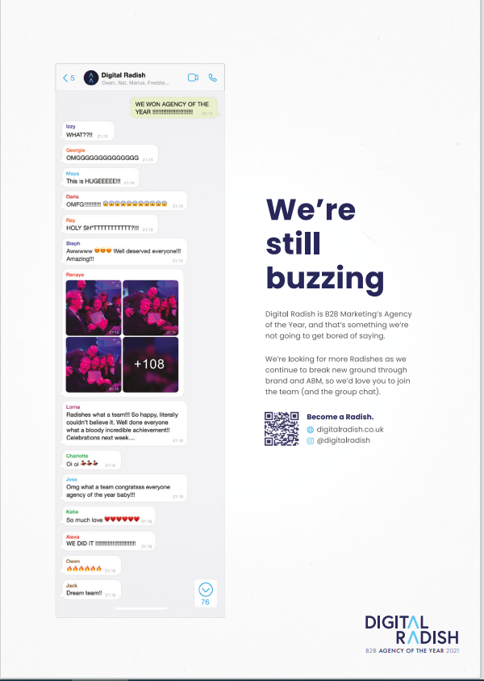
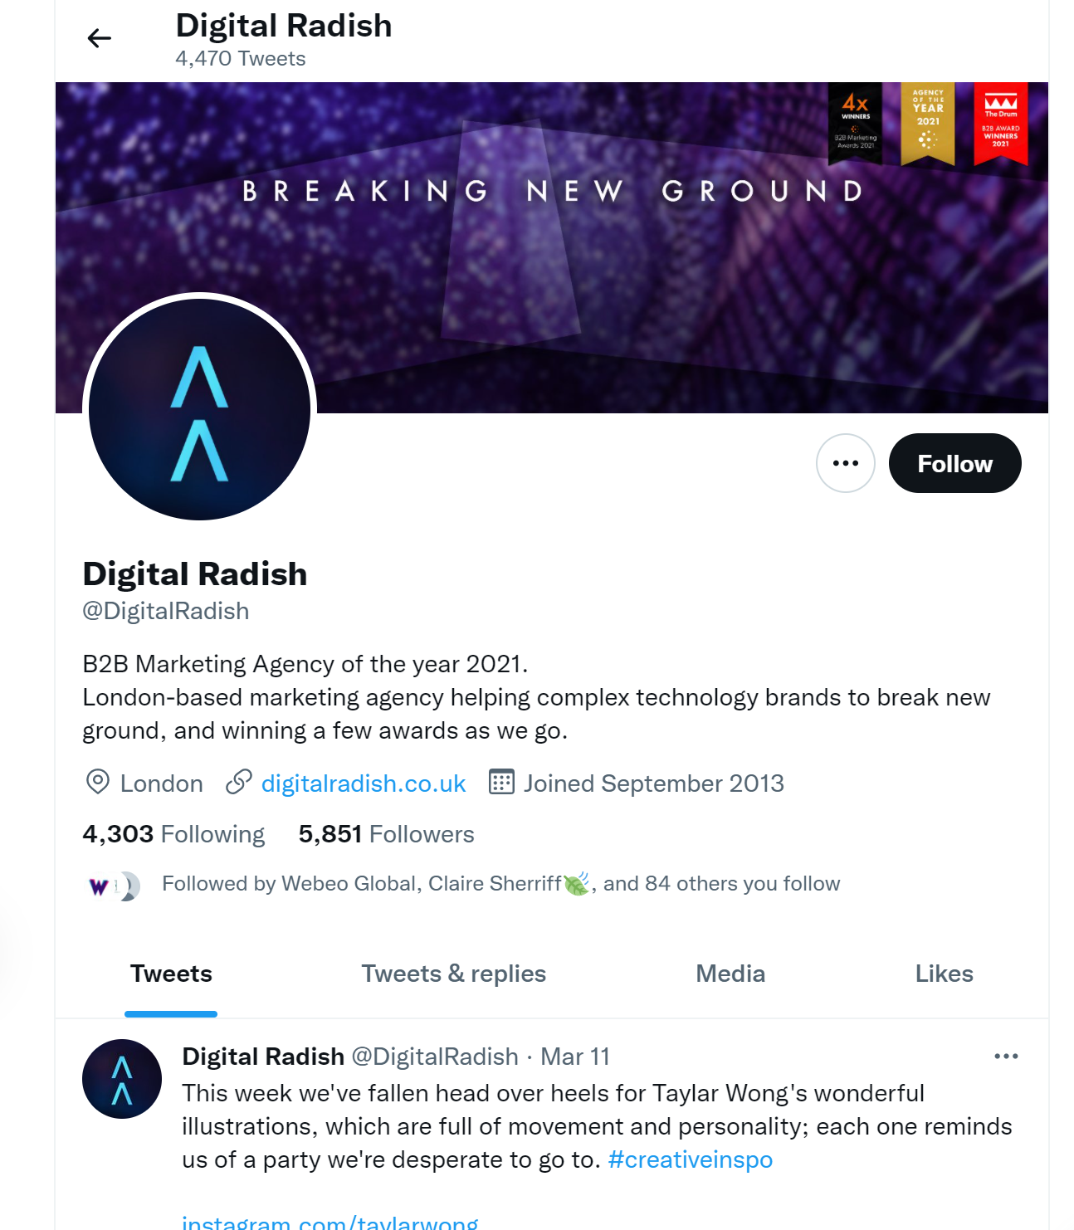
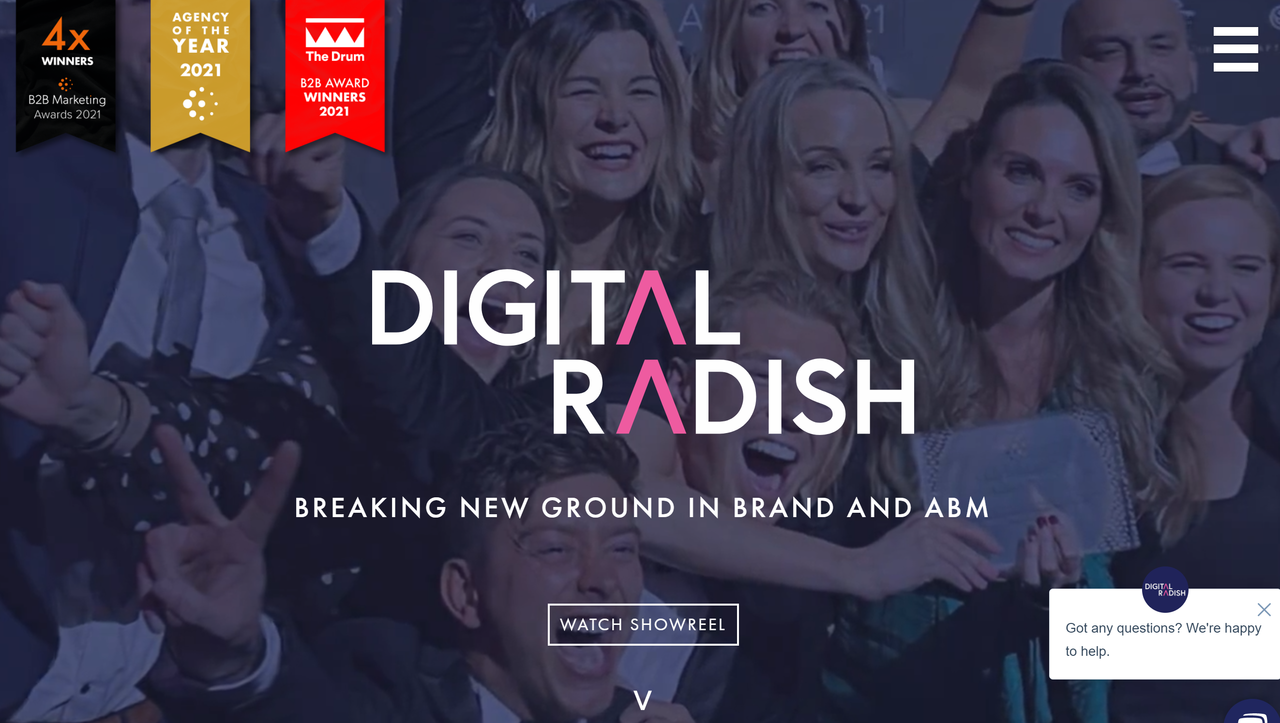
Digital Radish
Est – 2013
Employees – 34 – 6% 12 month growth
London
Agency of the Year – B2B Marketing. Cheryl moving there.

Slide 58
Octopush Group
Est – 2001 – part of Publicis Group UK
Employees – 182 – 8% 12 month growth
London
Agency of the Year – B2B Marketing. Chris M, Nic T, Kirstie Orpen, Tash V..
www.octopusgrp.com – “Everything we do is about helping B2B brands get to sales faster”
Brand to sales, Demand Gen, Content & Creative
Telecoms, Software/SaaS, Manufacturing
Adobe, Airbus, SSE/Neos
Socials – Twitter (f 3,217), LinkedIn (13,015), Facebook (f 275), Instagram (f 503)
Awards – Technology Agency of the Year – PR Moment Awards, B2B Marketing Awards Best Limited Campaign, Best SME targeted campaign, Best Use of PR, Best Campaign Using Humour.
Content – Weekly content uploaded in form of blogs covering thought leadership, informative commentary & company updates & wins. Most impressive in terms of very regular, consistent quality content.
Search – 436 paid clicks pm – estimated budget £5,330 – 854 organic clicks pm.

Slide 59
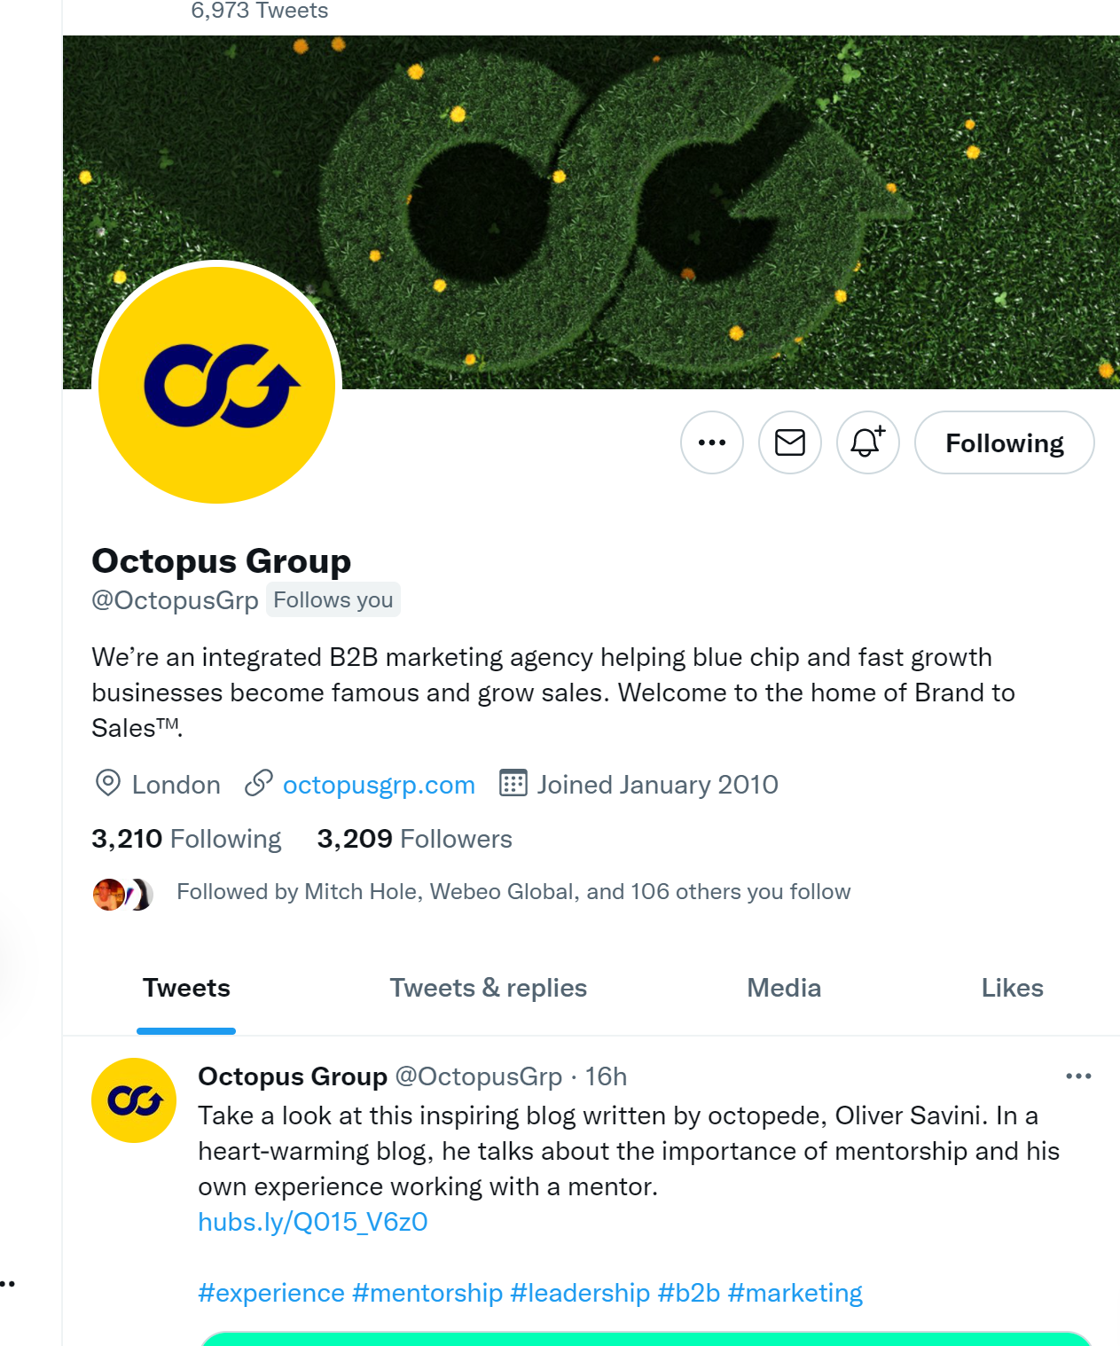
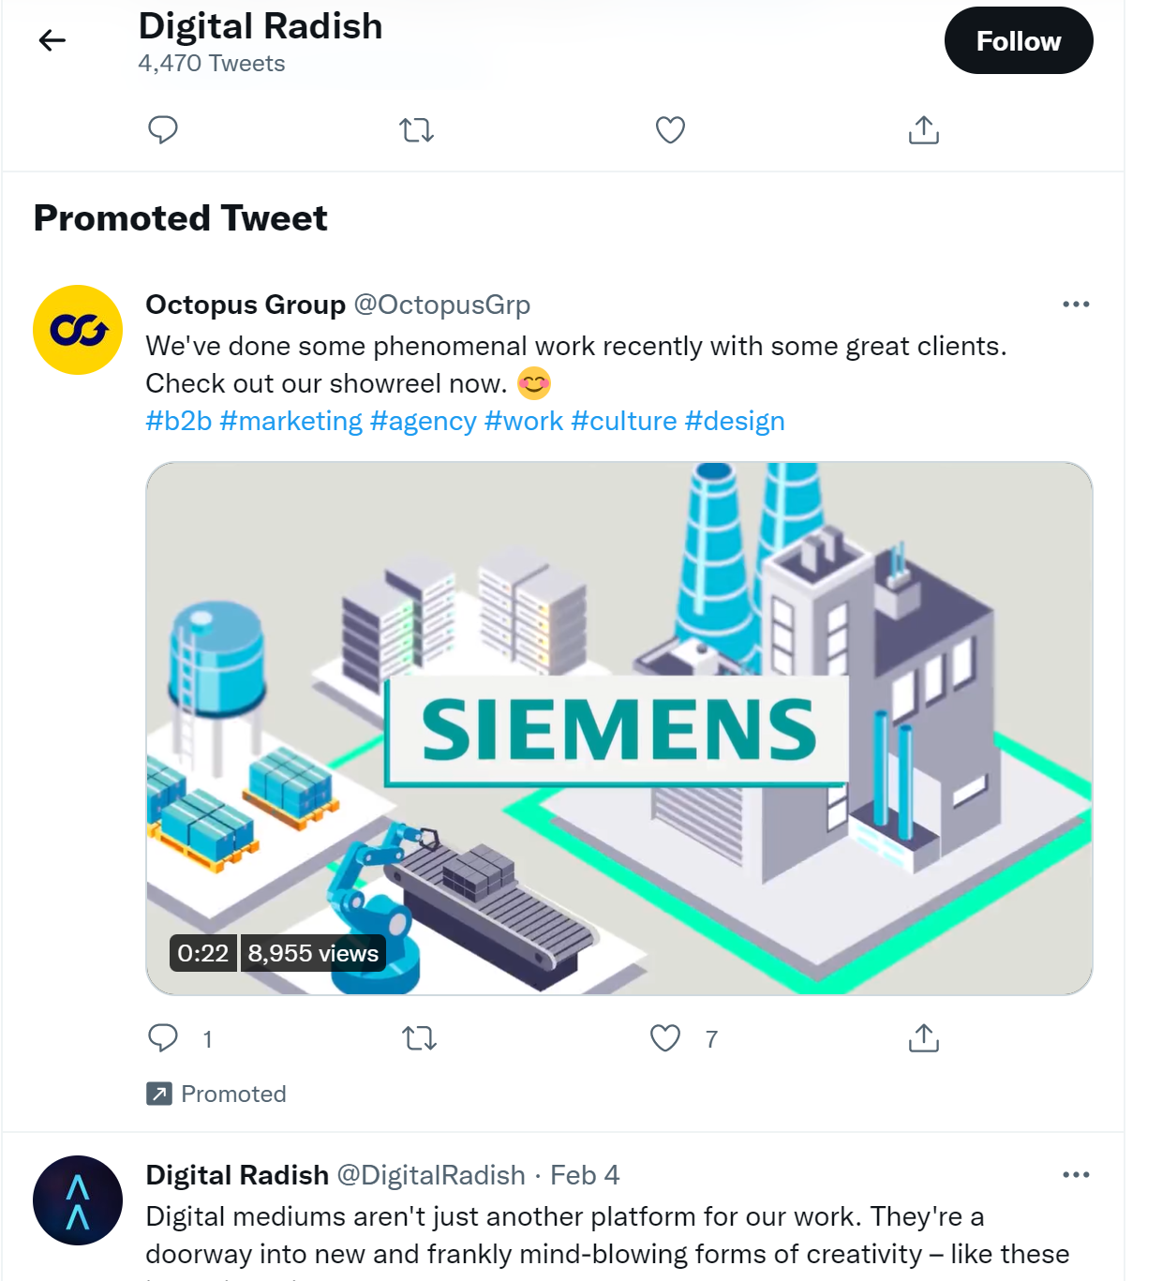
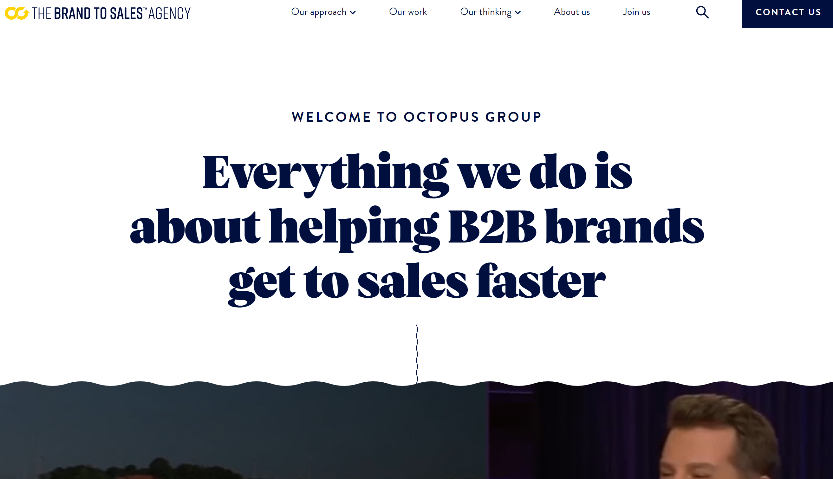
Octopush Group
Est – 2001 – part of Publicis Group UK
Employees – 182 – 8% 12 month growth
London
Agency of the Year – B2B Marketing. Chris M, Nic T, Kirstie Orpen, Tash V..

Slide 60
The Marketing Practice
Est – 2002
Employees – 241 – 14% 12 month growth
Oxfordshire
Identified in 2021 brand workshop
www.themarketingpractice.com – “We believe there’s a better way to do B2B marketing. And we’re building a growth platform to deliver it. In 2021 we acquired brand and digital experience agency Omobono, and media, data and audience insight agency Kingpin. Together we’re helping clients join up customer experience through the funnel and across channels.”
ABM, Demand Gen, Partner Marketing
Telecoms, Software/SaaS, Technology
O2 Business, Microsoft, Sage, Atos, Citrix
Socials – Twitter (f 2,194), LinkedIn (f 14,031), Facebook (f 558), Instagram (f 679)
Awards – ServiceNow ABM at B2B Awards, Best ROI campaign for Microsoft The Drum, Most Commercially Successful campaign.
Content – Good quality, varied content in form of reports, forums, interviews, insight, news & blog – one to mirror.
Search – No paid search – 607 organic clicks pm.

Slide 61
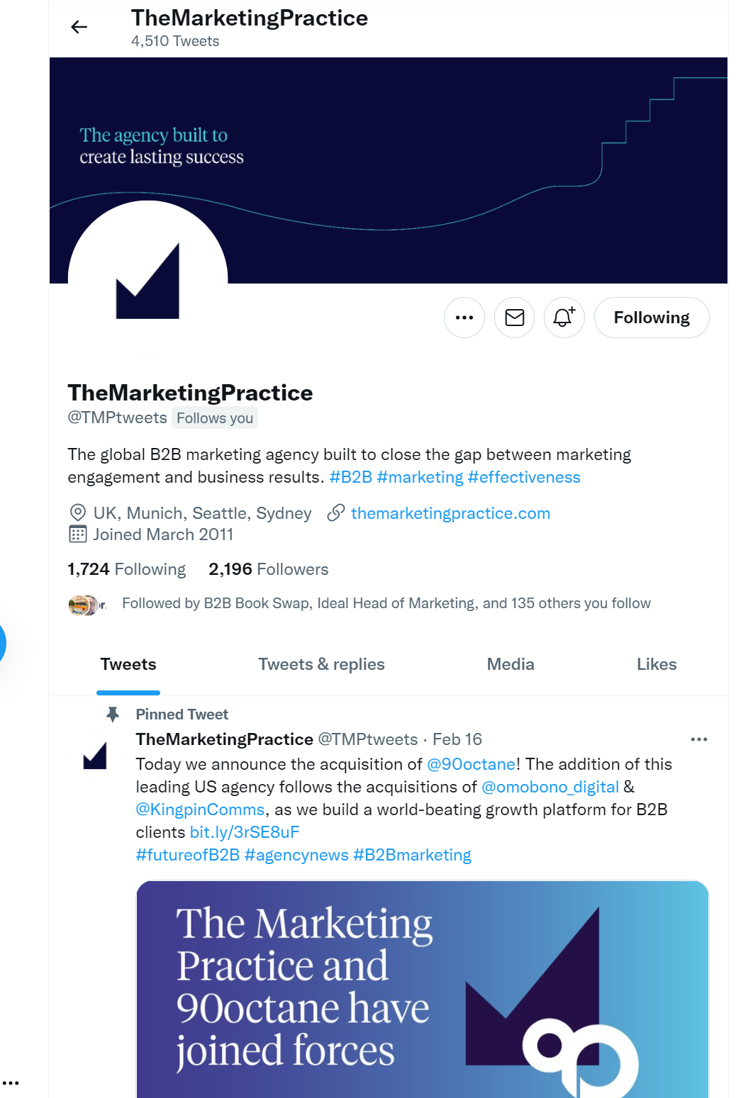
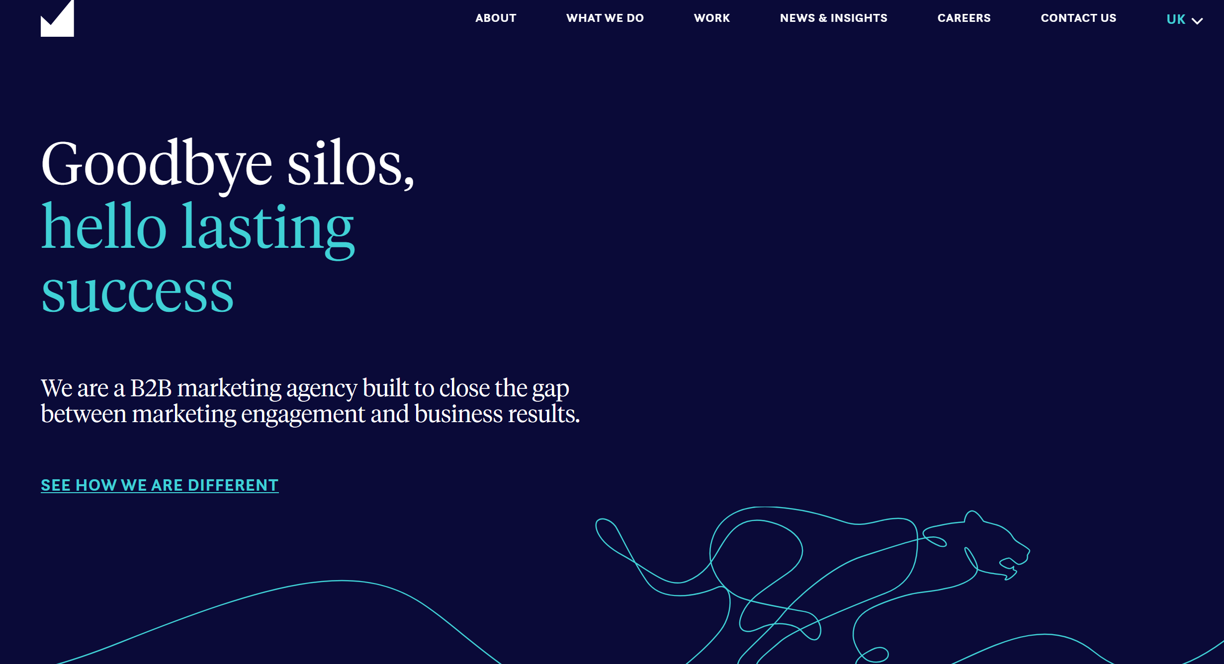
The Marketing Practice
Est – 2002
Employees – 241 – 14% 12 month growth
Oxfordshire
Identified in 2021 brand workshop

Slide 62
Purple Agency
Est – 2008
Employees – 129 - 1% 12 month growth
Basingstoke
www.purple.agency.com – “Part of HH Global We are an international marketing agency making communications that actually work”
ABM, Demand Gen, Content & Creative
Technology, Healthcare, Food & Beverages
IBM, Carlsberg, Pfizer – refer to clients at partners
Socials – Twitter (f 2,433) LinkedIn (f 6,819), Facebook (f 706), Instagram (f 742)
Awards – ServiceNow ABM at B2B Awards, Best ROI campaign for Microsoft The Drum, Most Commercially Successful campaign, Best Content Strategy and Creation agency The Drum.
Content – In from of ‘News’ – mainly with company updates typically award wins and ‘Views’ thought leadership, industry updates and standard blogs written by team members.
Search – No paid search – 239 organic clicks pm.

Slide 63
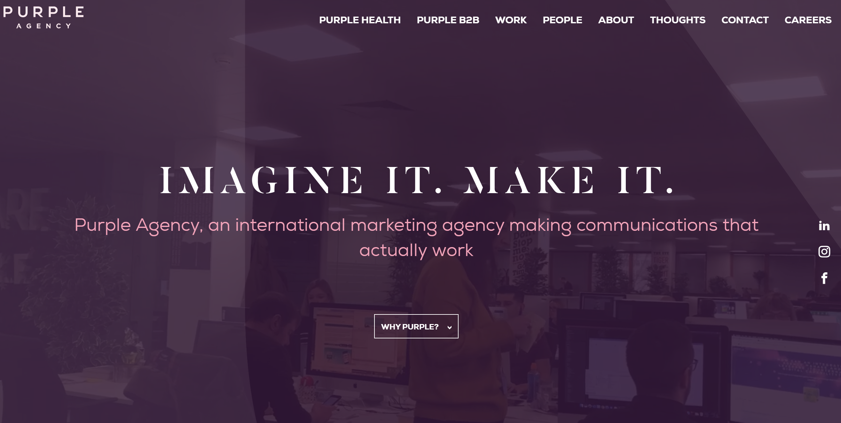
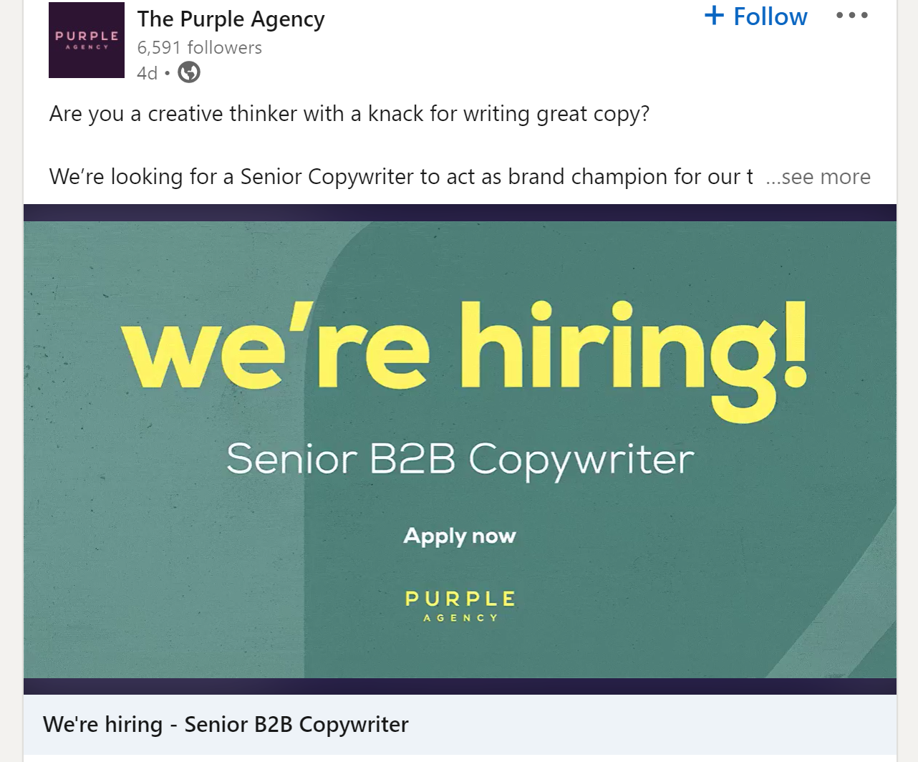
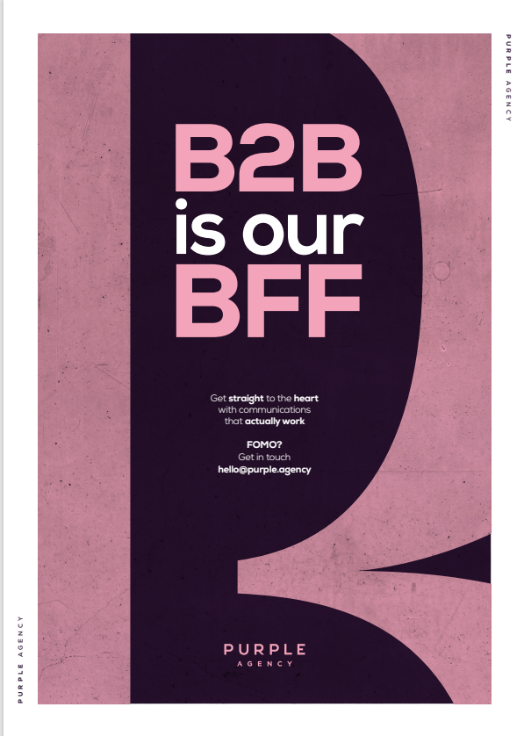
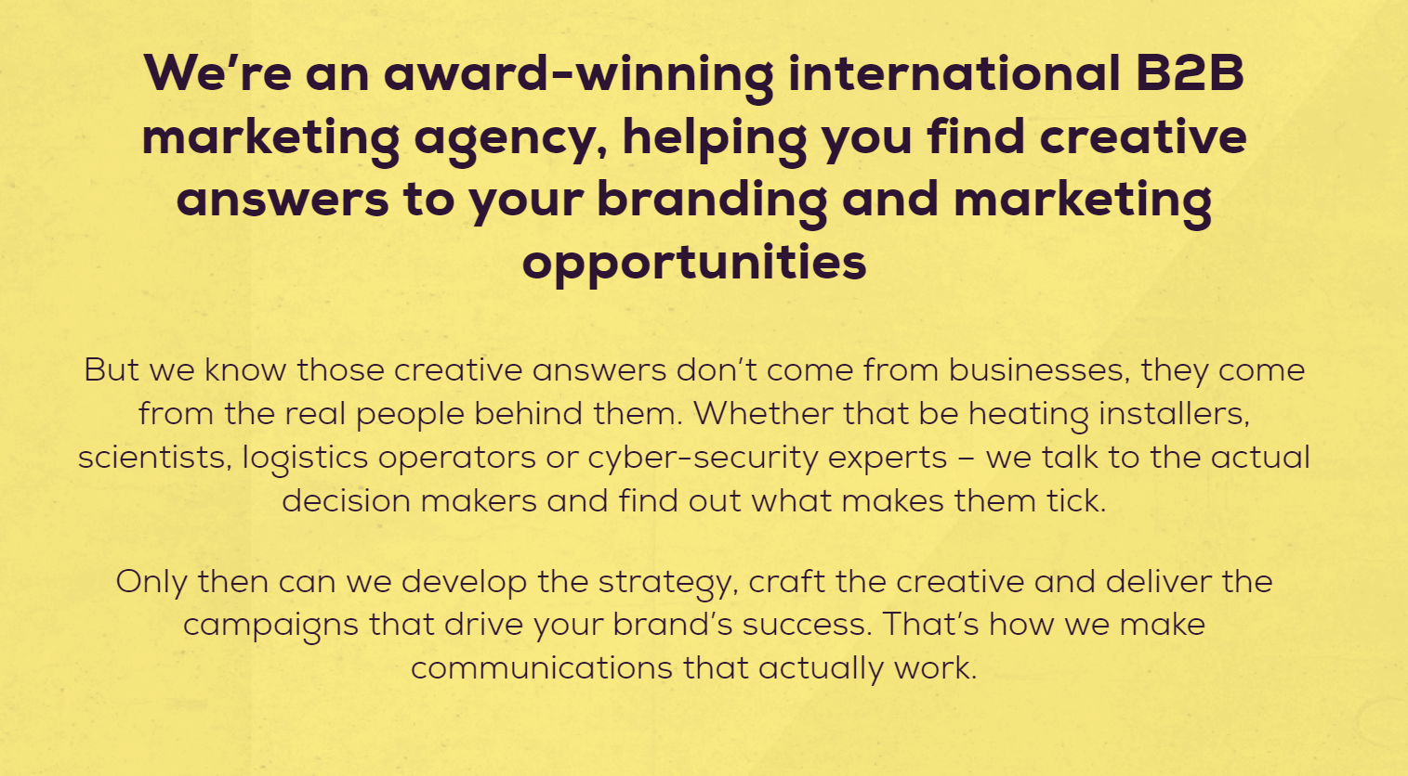
Purple Agency
Est – 2008
Employees – 129 - 1% 12 month growth
Basingstoke

Slide 64
The Croc
Est – 1990 – Founding member of the Affinita Network – a group of independent agencies.
Employees – 60 - -15% 12 month growth
London
Identified in 2021 brand workshop
www.thecroc.com – “Where Fierce Thinking lives. We are the Customer Experience agency for B2B brands and believe in the power of creativity to solve the toughest business challenges.”
Consultancy, Marketing Strategy, Marketing Automation
Technology, Manufacturing, Professional Services
Sohonet, ServiceNow, AppDynamics
Socials – Twitter (f 2,801), LinkedIn (f 10,001), Facebook (f 389), Instagram (f 347)
Awards – B2B Marketing – Gold, Best Creative Sohonet. Winner Best CX & Best Digital Technologies - ServiceNow, Drum Awards winner – best demand generation App Dynamics.
Content – Regular varied content in form of events news, ‘conversation’, Croc News, Brand, B2B insights
Search – 173 paid clicks pm – estimated budget £1517 – 226 organic clicks pm.

Slide 65
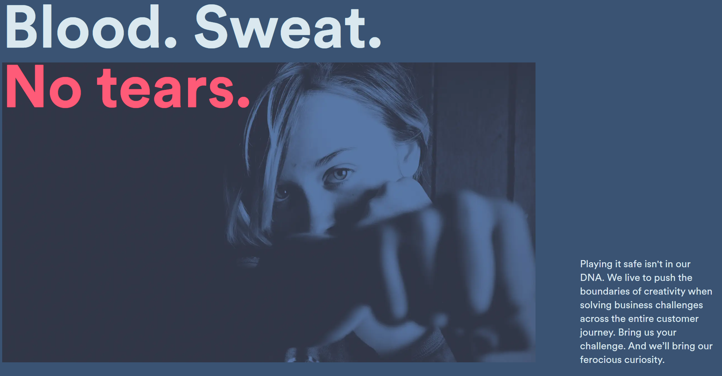
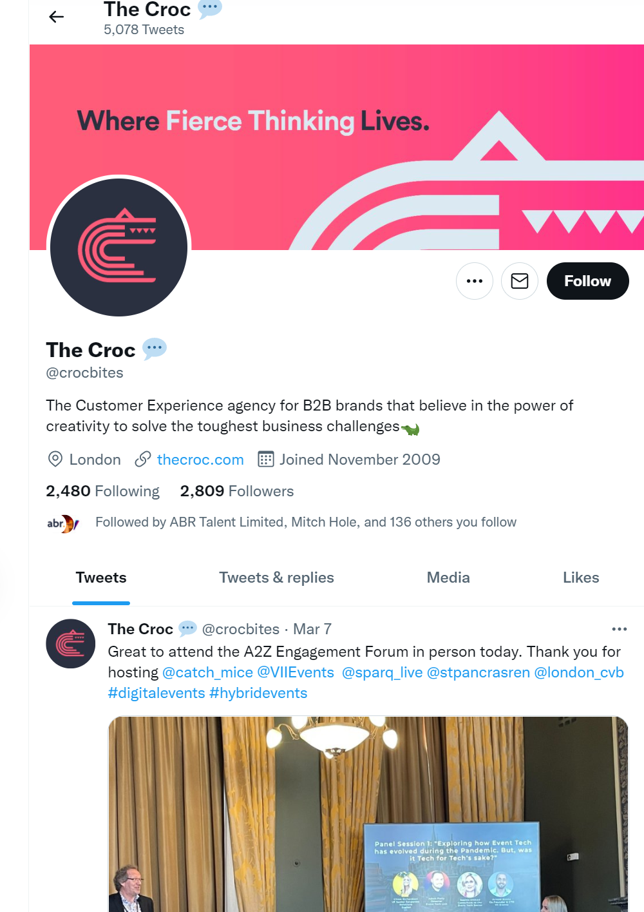
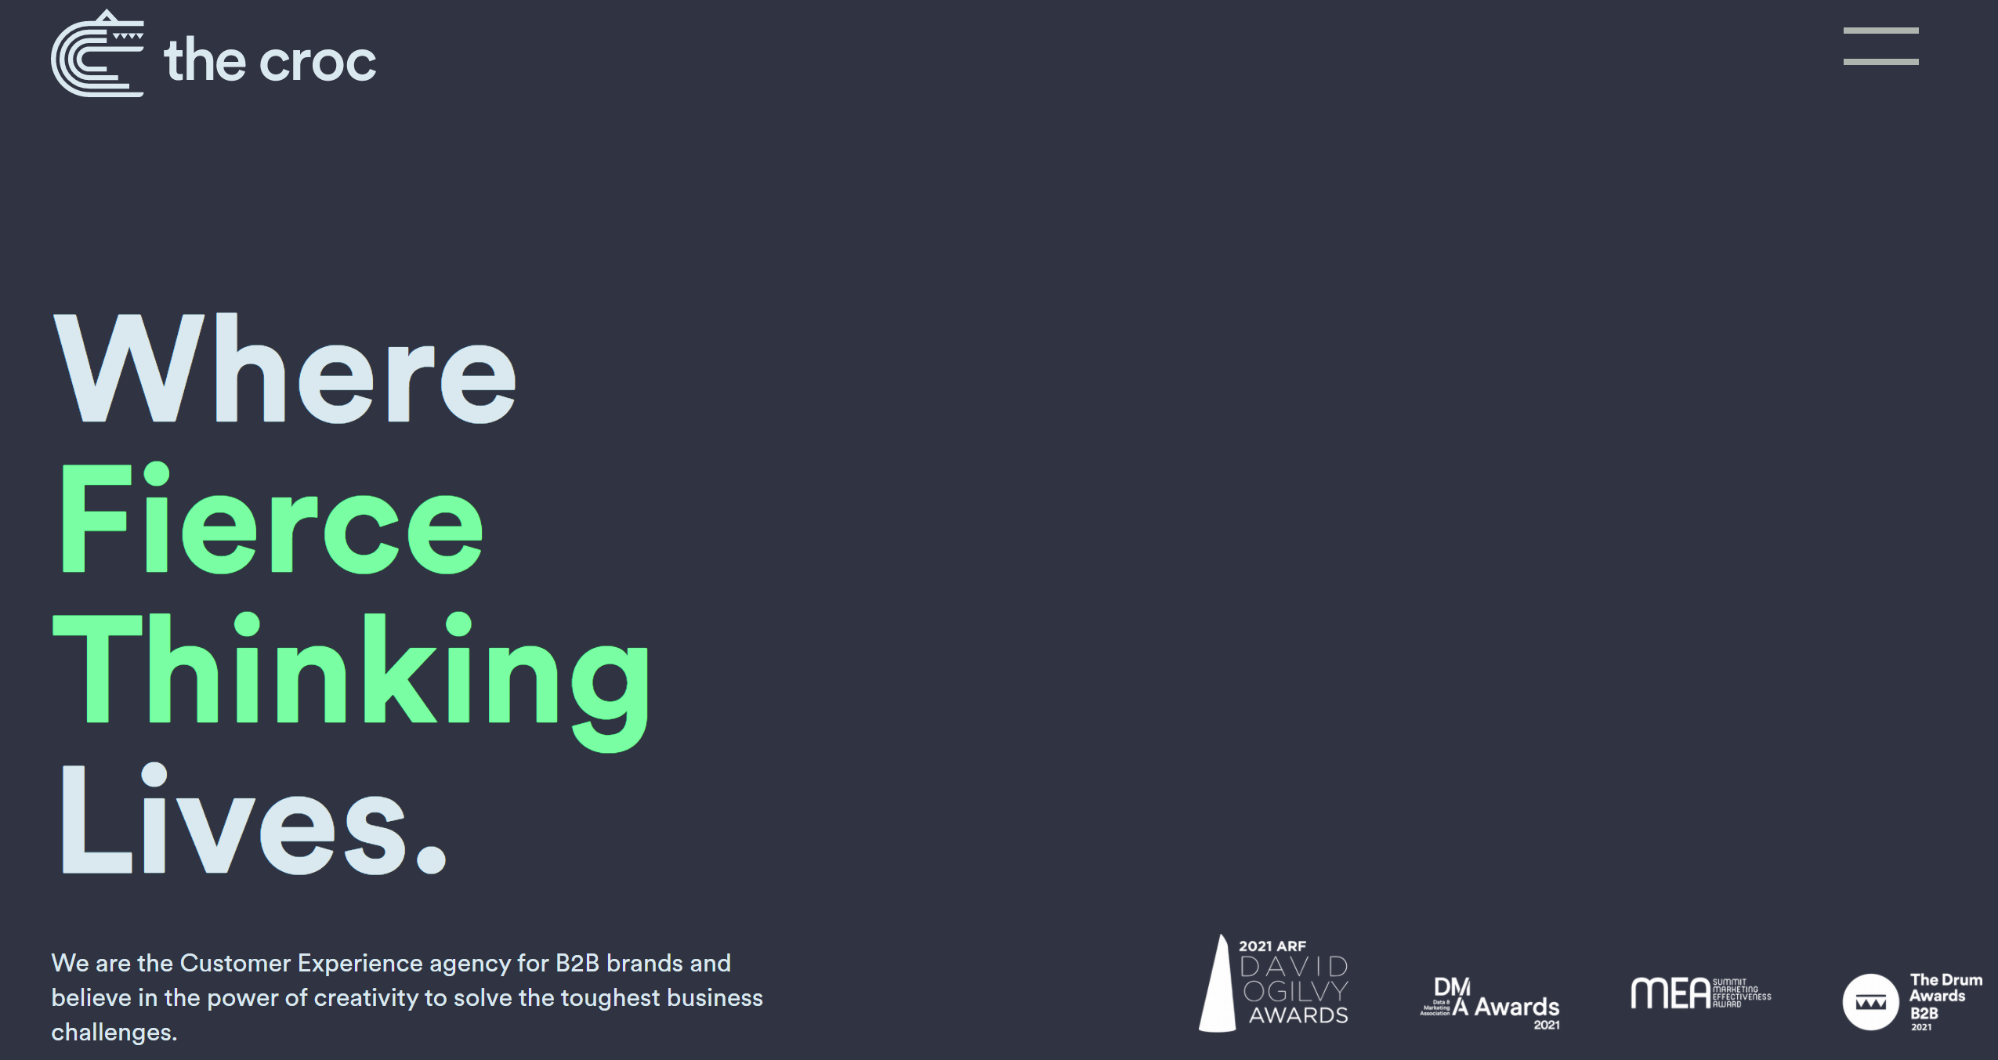
The Croc
Est – 1990 – Founding member of the Affinita Network – a group of independent agencies.
Employees – 60 - -15% 12 month growth
London
Identified in 2021 brand workshop

Slide 66
Torpedo
Est – 2003
Employees – 70 – 9% 12 month growth
Oxfordshire
Identified in 2021 brand workshop
www.torpedogroup.com – “Connected experiences for the world of business.”
ABM, Strategy & Planning, Digital
Technology, Manufacturing, Software/SaaS
Panasonic Business, Autodesk, Isuzu Trucks, Miele Professional
Socials – Twitter (f 1,042), LinkedIn (f 3,818), Facebook (f 279), Instagram (f 509)
Awards – The Drum – Email Marketing & Website Design.
Content – Infrequent monthly web content uploaded, fun company updates, awards wins, B2B Best practice Blogs, Team day in the life.
Search – 8 paid clicks pm – estimated budget £106 – 557 organic clicks pm.

Slide 67
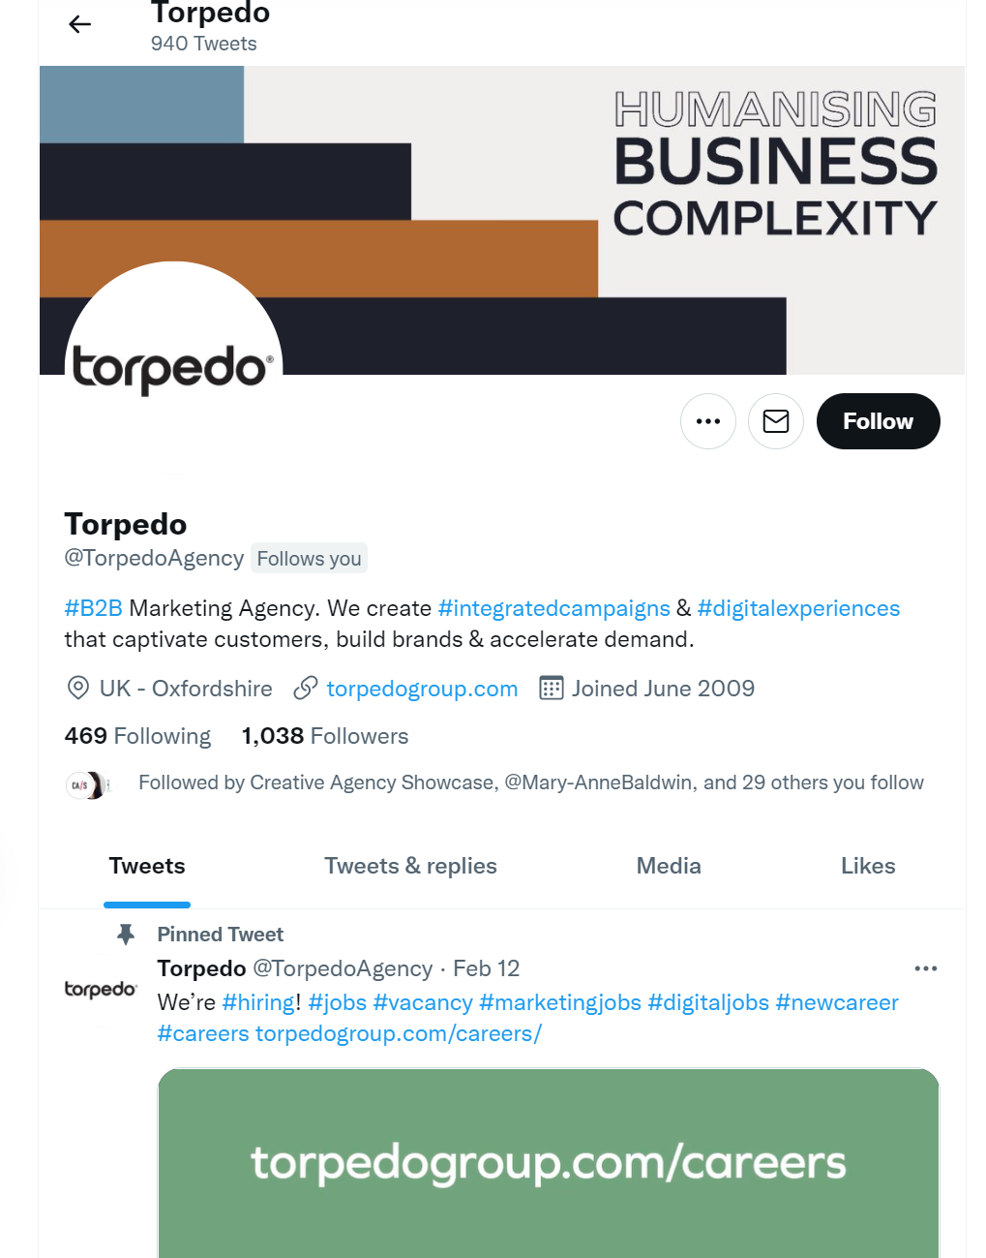
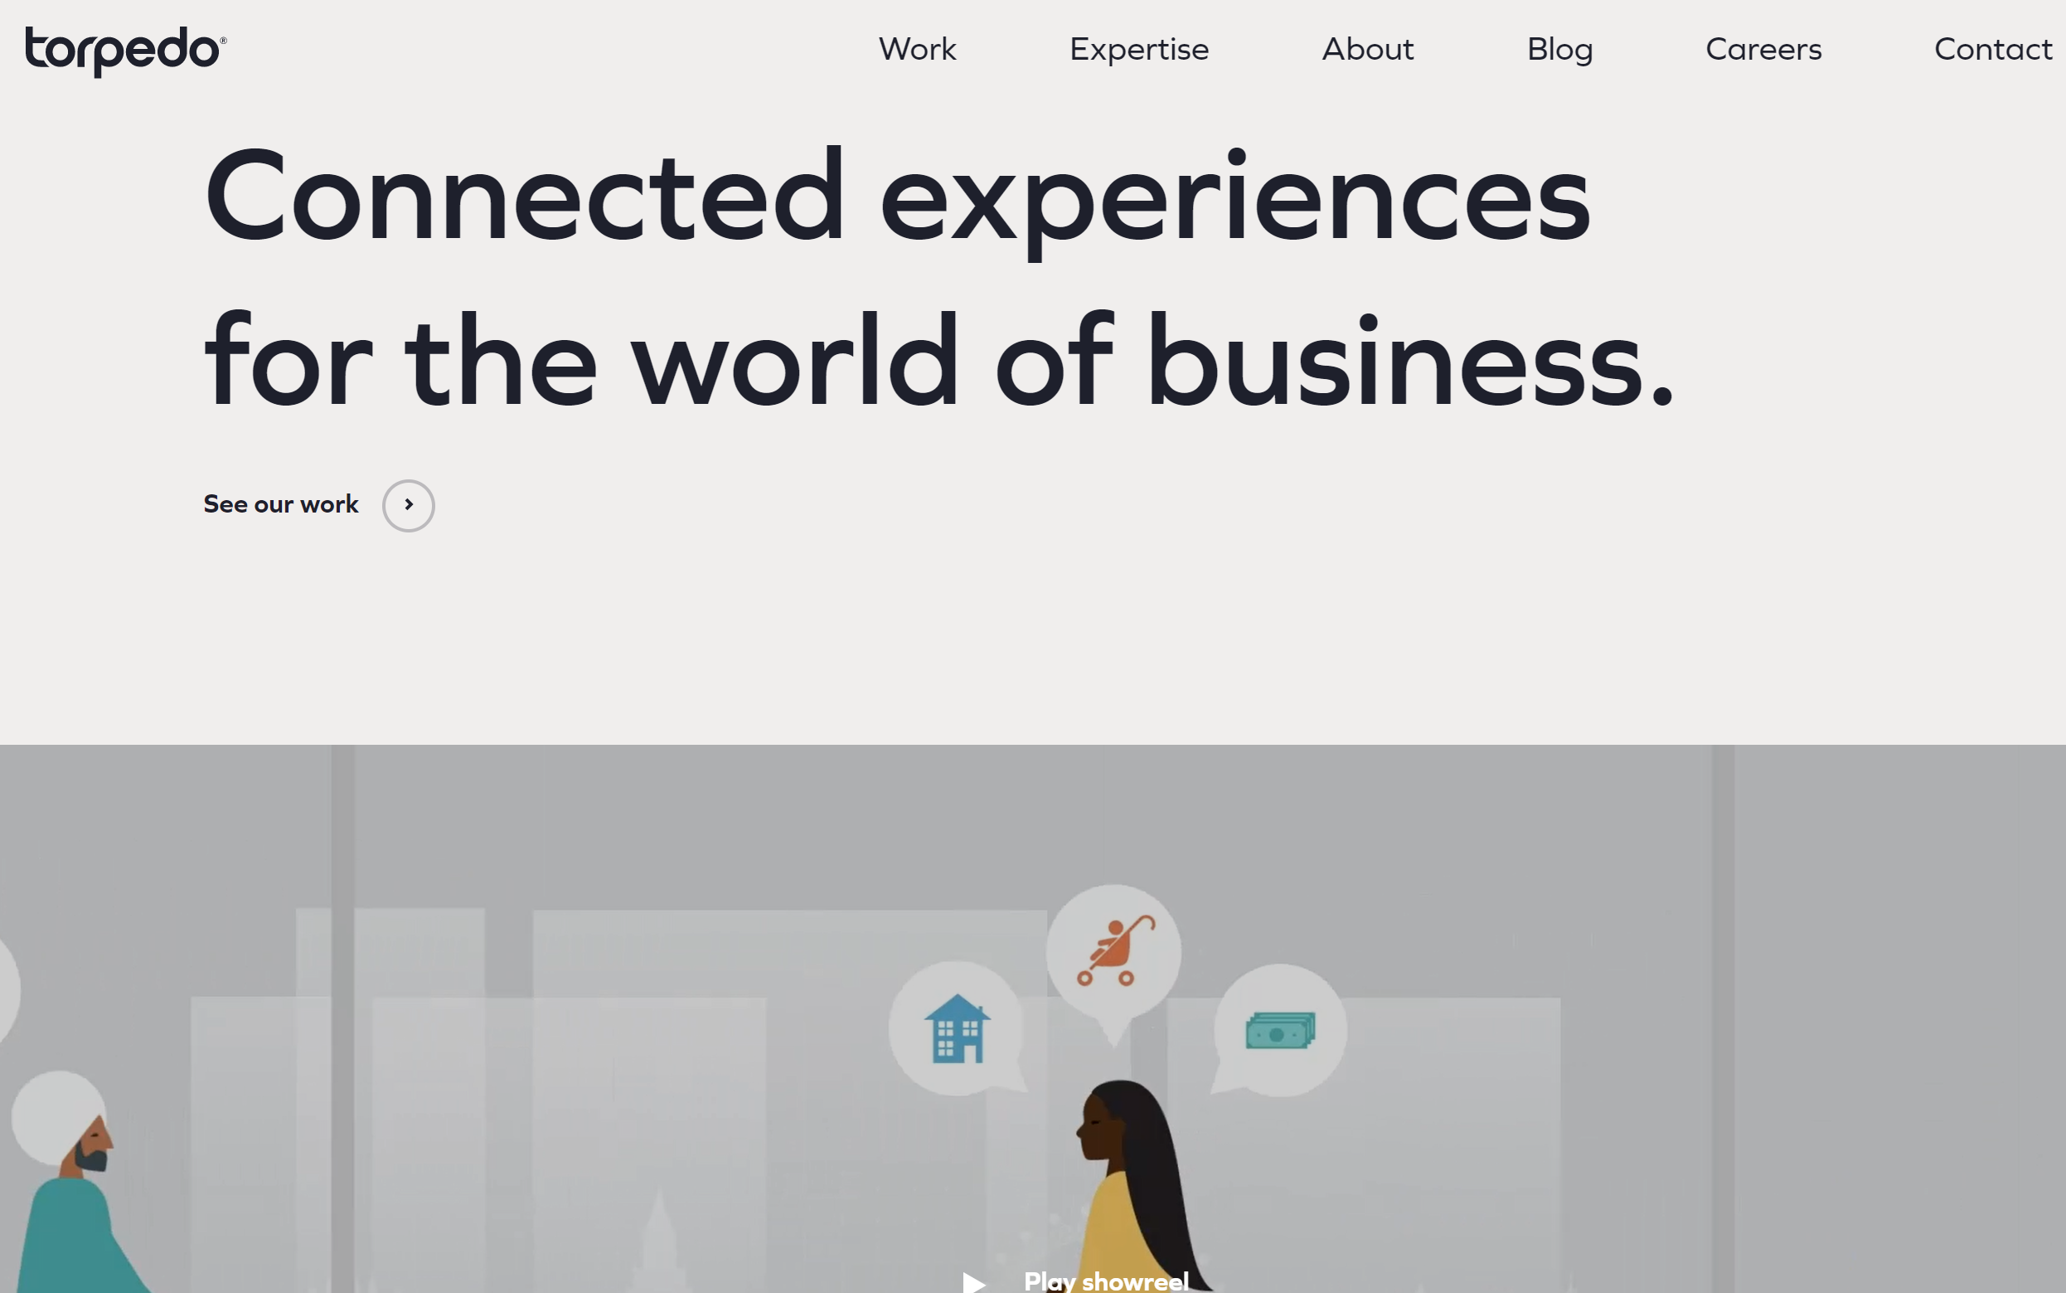
Torpedo
Est – 2003
Employees – 70 – 9% 12 month growth
Oxfordshire
Identified in 2021 brand workshop

Slide 68
Secondary

Slide 69
Agent 3
Est – 2013 – part of Next15 digital communications group portfolio
Employees – 120 – 27% 12 month growth
London
Metlife went with, Kristina Haddrell moved to
www.agent3.com – “Turn chaos into clarity - ABM with the power of data, creativity and technology, together.”
Insight & Intelligence, Strategy & Planning, Content & Creative
Technology, Telecoms, Software/SaaS
BT, Cisco, Salesforce, Sony
Socials – Twitter (f 739), LinkedIn (f 4,485), Facebook (f 48) Instagram (f 227)
Awards – Winners ITSMA Marketing Excellence Awards,
Content – Regular content in form of blogs, guides & video. Several updates & wins seem to celebrate the wider large group of companies rather than specifically Agent 3.
Search – No paid search – 172 organic clicks pm.

Slide 70
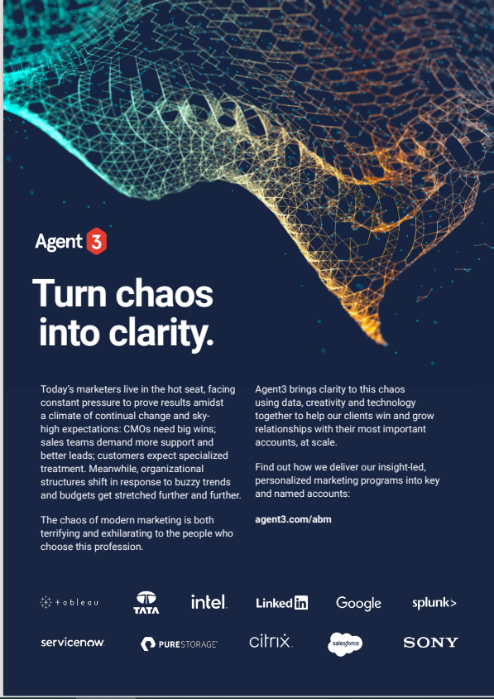
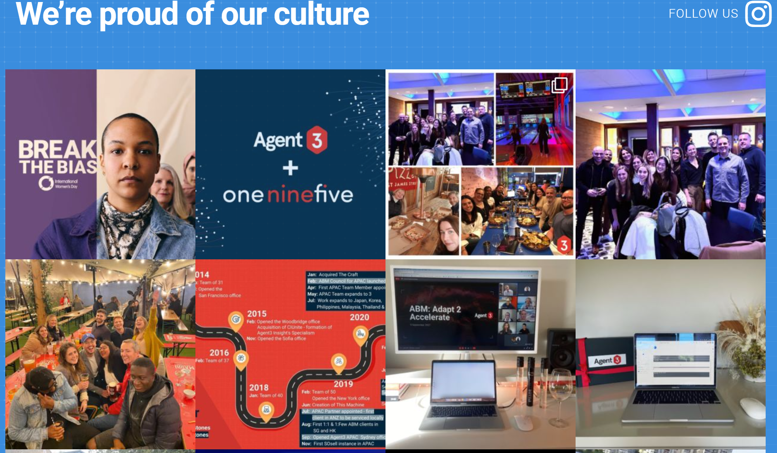
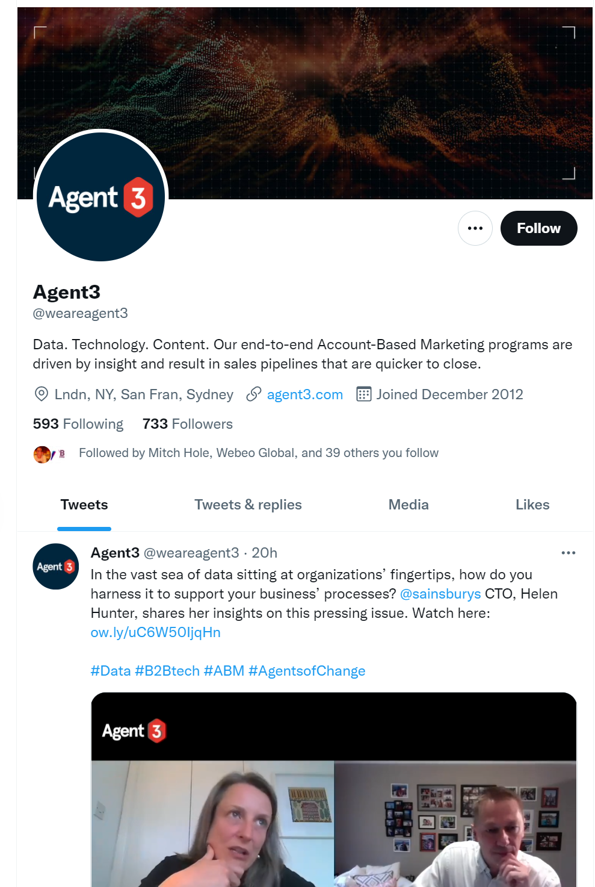
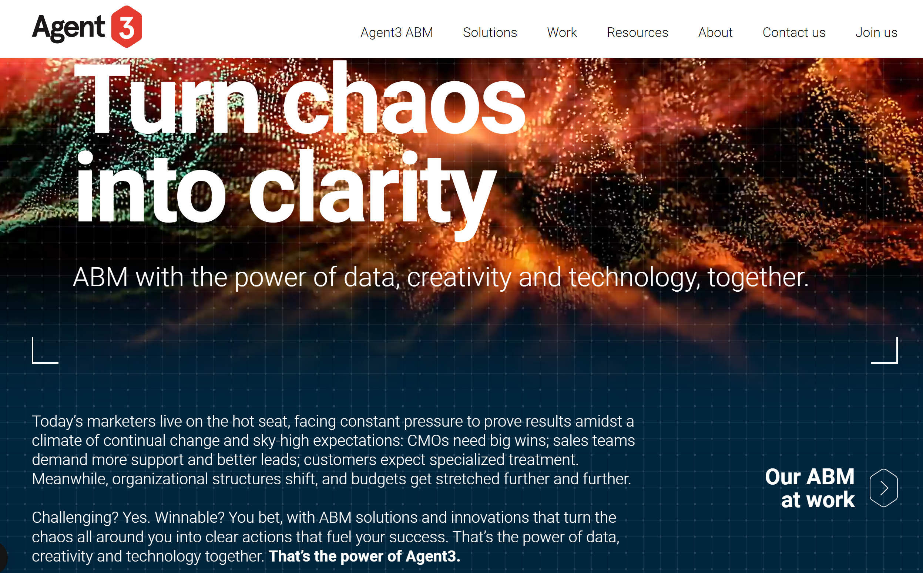
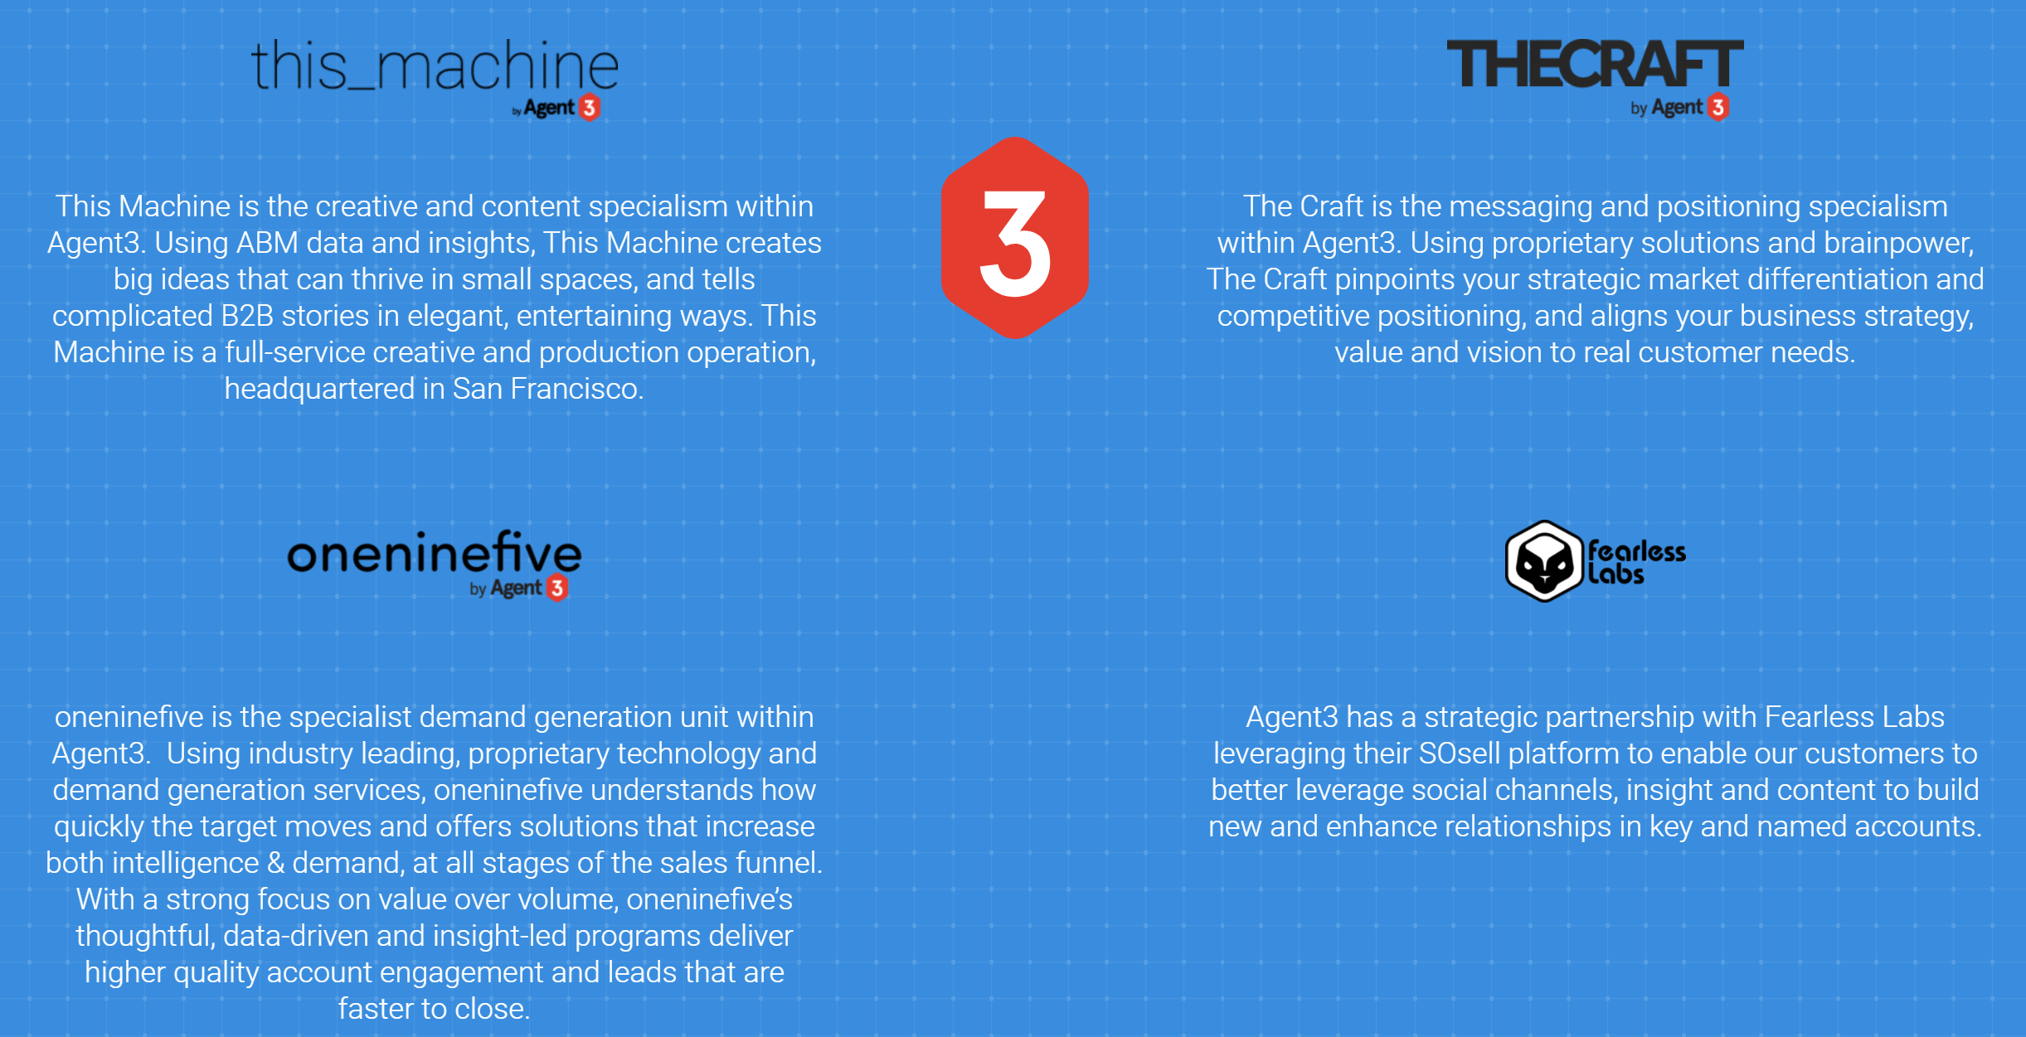
Agent 3
Est – 2013 – part of Next15 digital communications group portfolio
Employees – 120 – 27% 12 month growth
London
Metlife went with, Kristina Haddrell moved to

Slide 71
Twogether
Est – 2014 – part of Next15 portfolio – same as Agent3
Employees – 172 – 19% 12 month growth
Buckinghamshire
Identified in 2021 brand workshop
www.wearetwogether.com – “The multi-award winning, global B2B marketing agency with a 100% focus on Technology. And the only one able to deliver a total service, fully-integrated,
in-house.”
ABM, Strategy & Planning, Digital
Manufacturing, Software/SaaS, Technology
Adobe, ADP, AWS, Dell, Hitachi
Socials – Twitter (f 1,390), LinkedIn (f 4,472), Instagram (f 267), Facebook (f 443)
Awards – #1 fastest growing B2B agency in B2B agency league table 2021 (credit immersion in B2B tech), 2020 B2B Marketing agency of the year
Content – Podcast (50+ episodes) available on Stitcher, Apple & Spotify. Regular 3 minute read blogs.

Slide 72
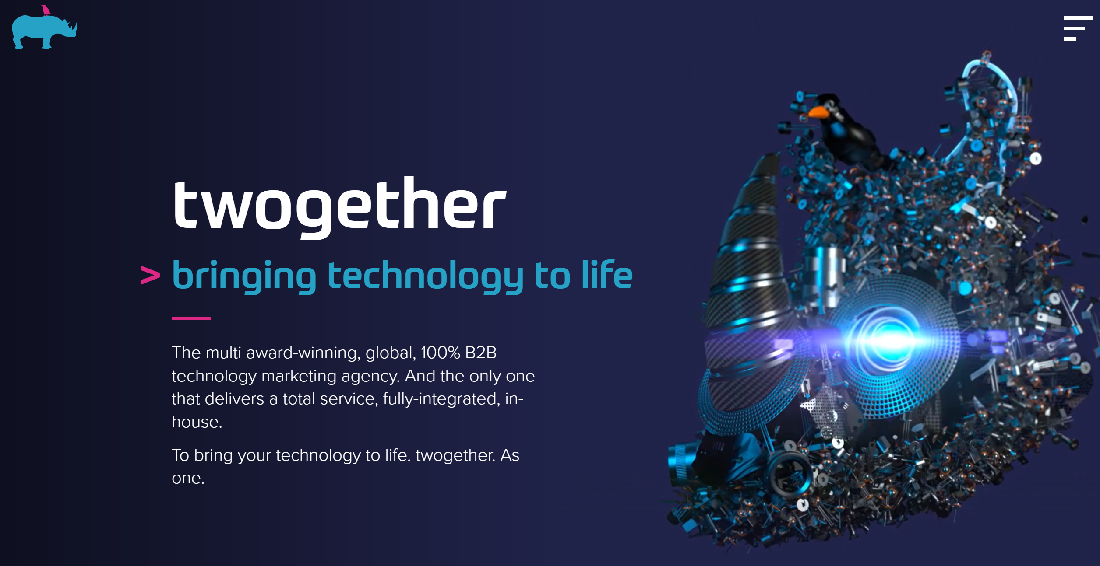
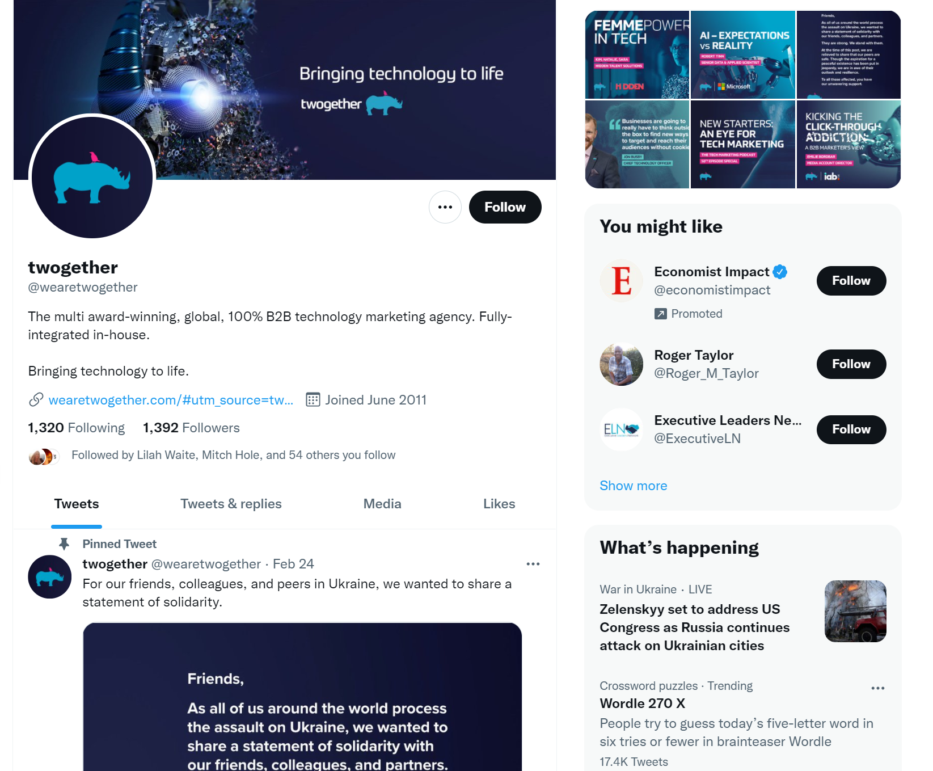
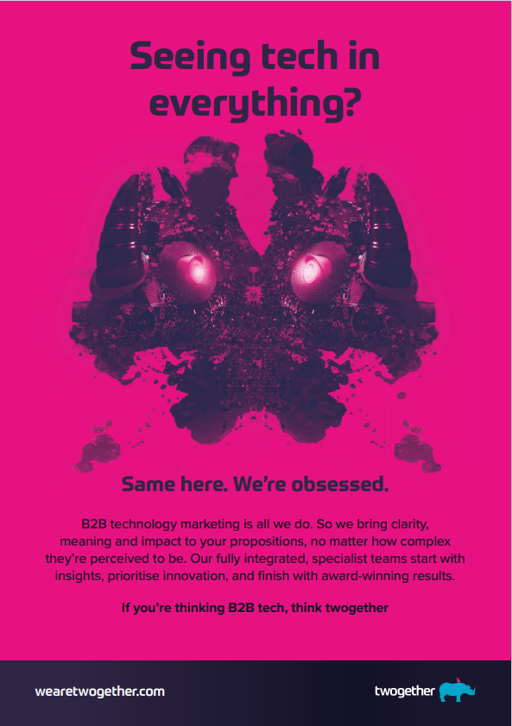
Twogether
Est – 2014 – part of Next15 portfolio – same as Agent3
Employees – 172 – 19% 12 month growth
Buckinghamshire
Identified in 2021 brand workshop

Slide 73
Ambition ABM
Est – 2019
Employees – 4 – 33% 12 month growth
London
New challenger brand
www.ambitionabm.com – “Accelerating the relationships that matter. AmbitionABM is an award-winning pure-play ABM agency. We are experts in the strategy, data deep dives, digital platforms and compelling creative content that are hallmarks of successful ABM campaigns.”
ABM, Sales Enablement, Content
Business Intelligence
Refinitiv
Socials – Twitter (f 215), Linkedin (f 658), Instagram (f 2), Facebook N/A
Awards – #1 fastest growing B2B agency in B2B agency league table 2021 (credit immersion in B2B tech), 2020 B2B Marketing agency of the year
Content – Podcast (50+ episodes) available on Stitcher, Apple & Spotify. Regular 3 minute read blogs.
Search – No paid search – 6 organic clicks pm.

Slide 74
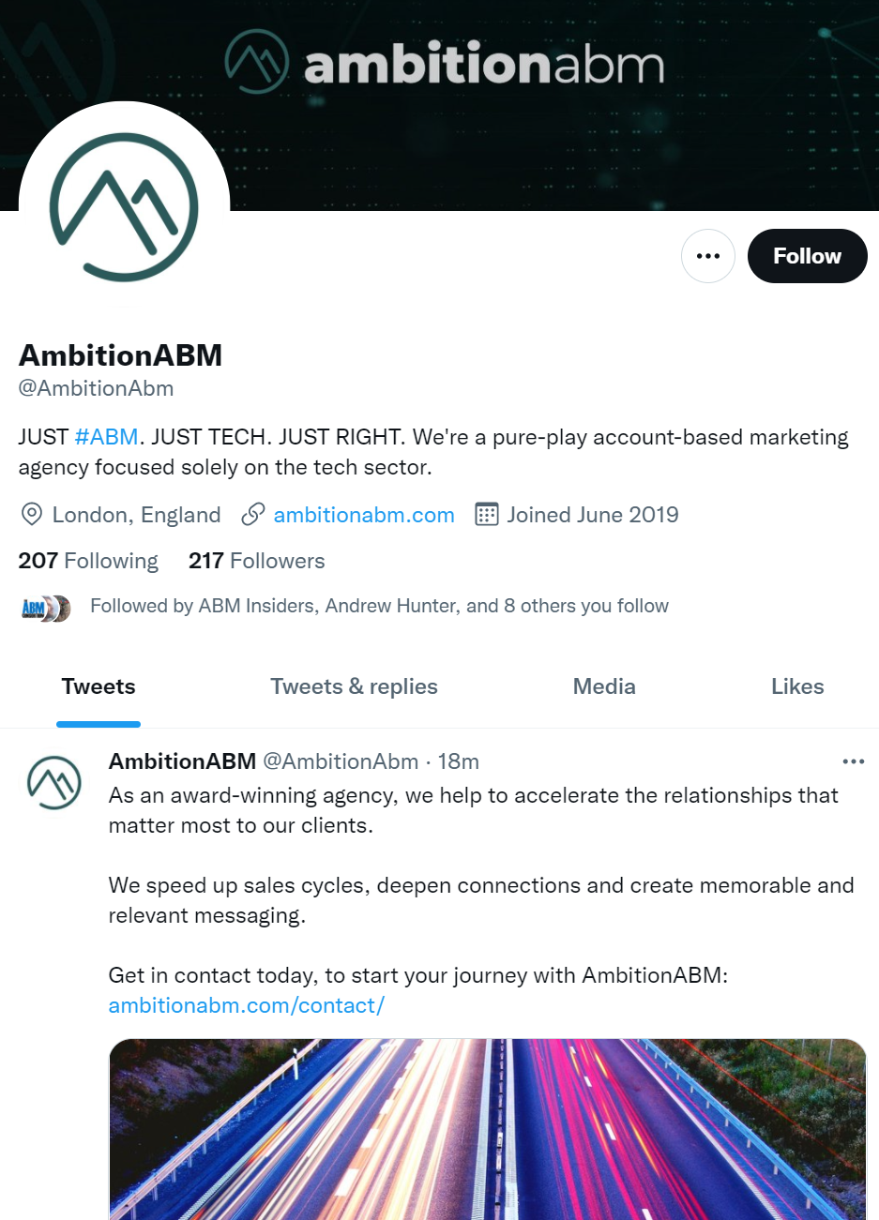
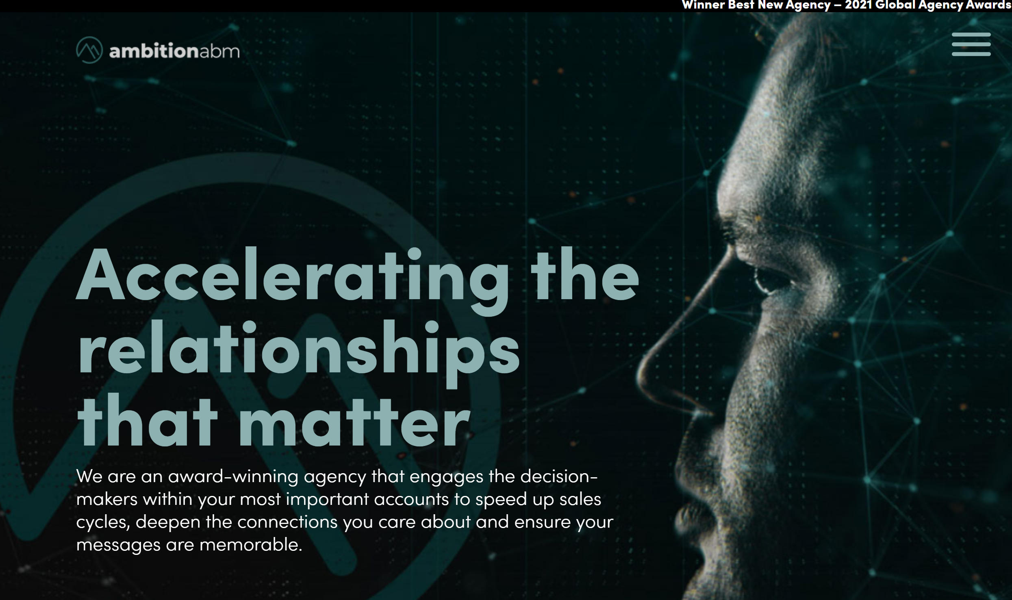
Ambition ABM
Est – 2019
Employees – 4 – 33% 12 month growth
London
New challenger brand

Slide 75
Punch
Est – 2014
Employees – 56 – 5% 12 month growth
London/Dubai
Identified in 2021 brand workshop – Hollie Ingram/Olga moved to
www.punchabm.com – “B2B marketing agency obsessed with growth”
ABM, Video, Content & Creative
Professional Services, Software/SaaS, Technology
Sage, Zendesk, Pitney Bowes
Socials – Twitter (f 1,262) Linkedin (f 2,786), Instagram (f 541)
Awards – #1 fastest growing B2B agency in B2B agency league table 2021 (credit immersion in B2B tech), 2020 B2B Marketing agency of the year
Content – Infrequent website content in form of blogs – focused on ABM & B2B with occasional team update.
Search – No paid search – 150 organic clicks pm.

Slide 76


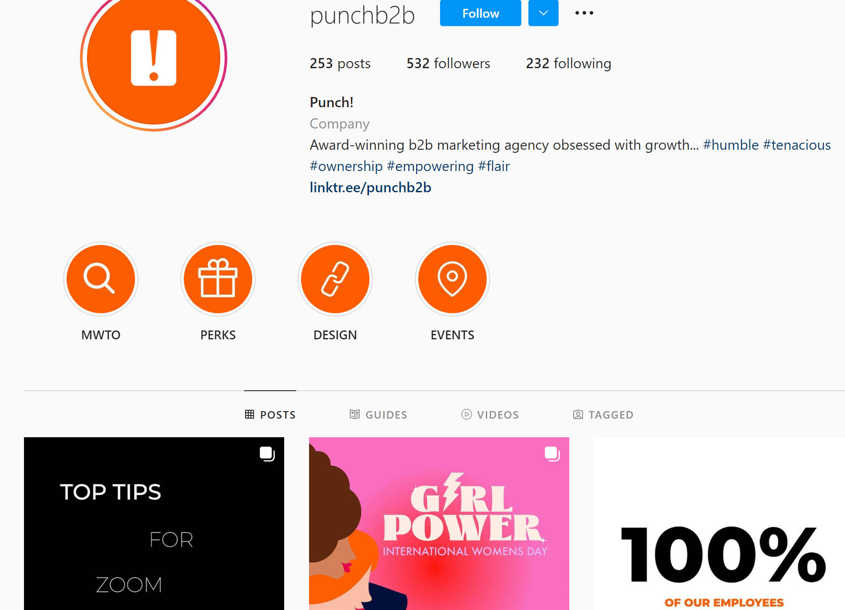
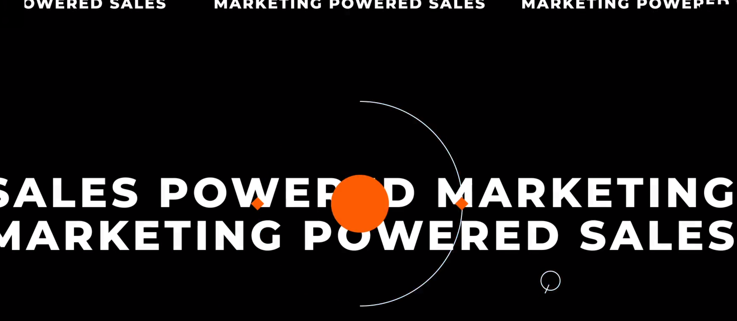
Punch
Est – 2014
Employees – 56 – 5% 12 month growth
London/Dubai
Identified in 2021 brand workshop – Hollie Ingram/Olga moved to

Slide 77
True Agency
Est – 2012 – part of BBN International
Employees – 43 – 26% 12 month growth
London
Identified in 2021 brand workshop
www.trueagency.com – “Make it memorable, Award Winning creativity & media powered by next generation audience intelligence”
Brand Strategy, Content & Creative, Media & Advertising
Professional Services, Software/SaaS, Technology
Kaspersky, HP, Micro Focus, Cisco, OKI, Yell, EY
Socials – Twitter (f 1,011), LinkedIn (1,204), Instagram (f 1,479), Facebook (f 171)
Awards – ANA Global B2B creative agency of the year, Grand Prix Winner B2B Marketing Awards – The
Drum Awards Best B2B content campaign, Best social media campaign, Best Brand campaign,
Best B2B2C campaign and Marketing Week B2B Sector Masters
Content – Infrequent website content in form of blogs – focused on ABM & B2B with occasional team
update.
Search – No paid search – 167 organic clicks pm.

Slide 78

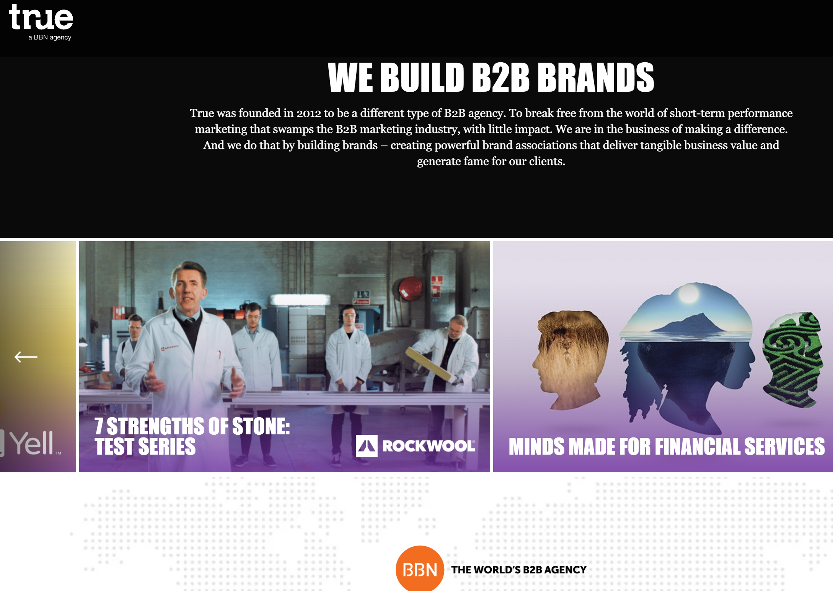
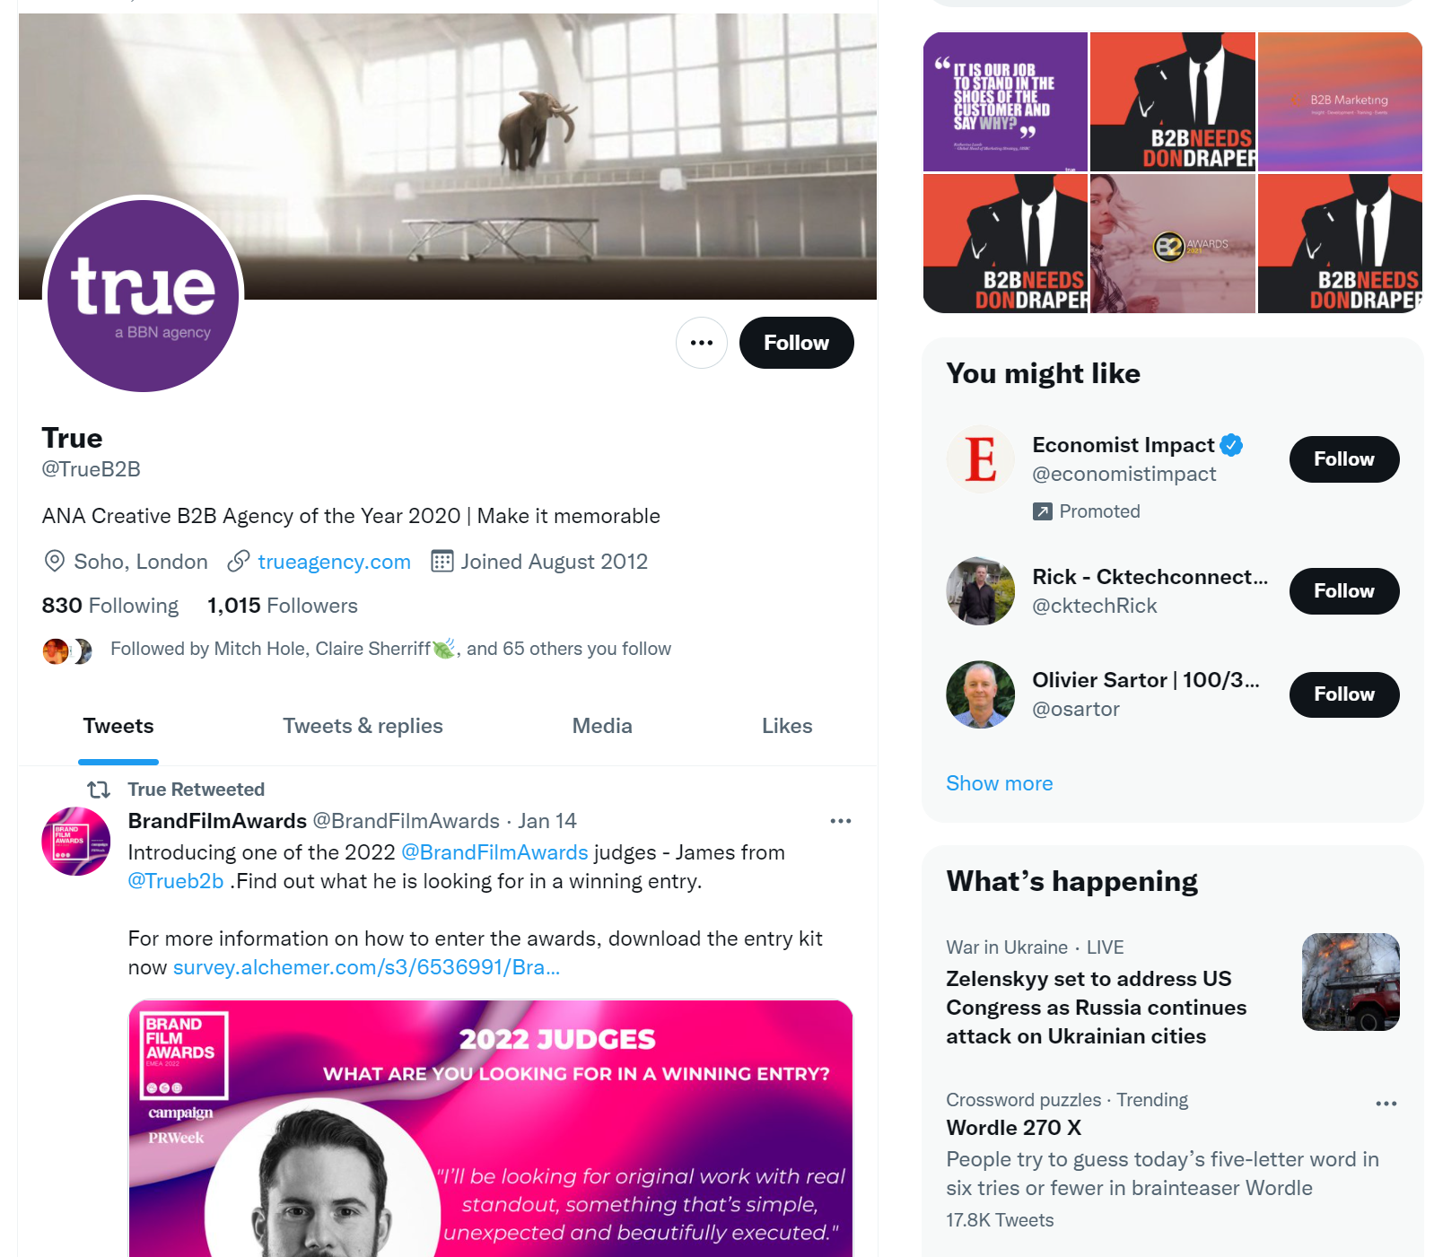
True Agency
Est – 2012 – part of BBN International
Employees – 43 – 26% 12 month growth
London
Identified in 2021 brand workshop

Slide 79
Tertiary

Slide 80
Account Engagement Platform
Grow pipeline & revenue with an end-to-end account-based platform designed for you entire go-to-market team
6sense brings sales, marketing and operations teams together by identifying the best accounts and contacts to work, the right time to work them and the topics they care most about
Identify accounts looking for your solution. Prioritise efforts. Engage the right way. Measure what matters.
Improve your visibility with a GTM platform that injects Account Intelligence into every step of the buying journey. You’ll spot in-market opportunities sooner. Progress them faster. And hit your pipeline goals quarter after quarter.
Integration – plug and play with leading technologies
ABX Cloud - ABM reinvented around customer experience
Account Intelligence – a hi-def view of accounts
For marketing, sales & post-sales
Unlock ABM campaign success with Triblio
Triblio’s AI-powered ABM platform can uncover new opportunities and attribute pipeline to your ABM campaigns. Complete the form to the right to see a demo.
Use predictive intent data to find the hottest accounts before they reach your pipeline, or even your target account list. Combine first and third party intent to precisely segment accounts based on buyer signals and then orchestrate cross channel ABM campaigns with unified messaging.

Slide 81
Competitor Creative Examples

Slide 82
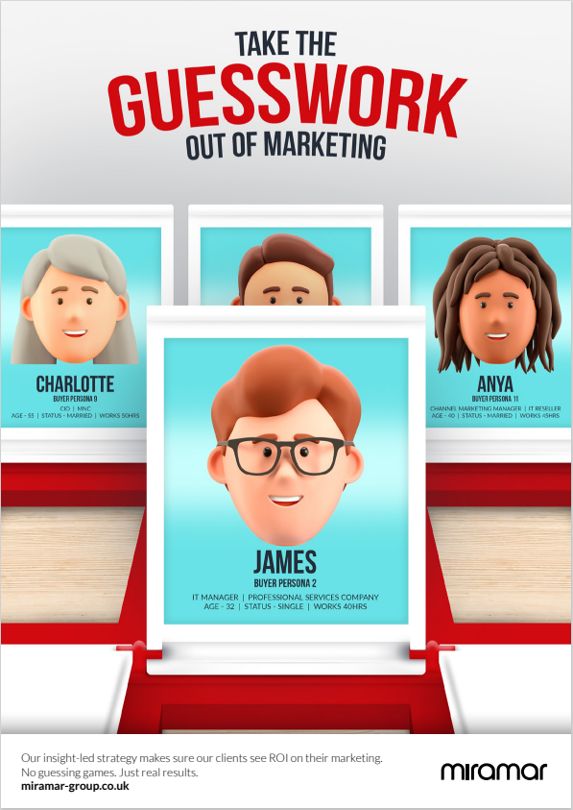

Notes:
Technology – 17 – SaaS 10 – Software 10 – Telecoms – 7 – Manufacturing 7 – Food & Beverage 6 – Financial Services 5 – FMCG 5

Slide 83
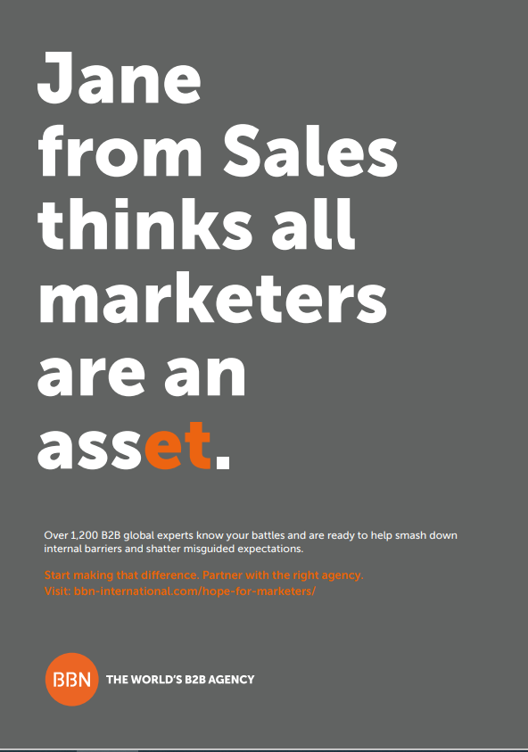
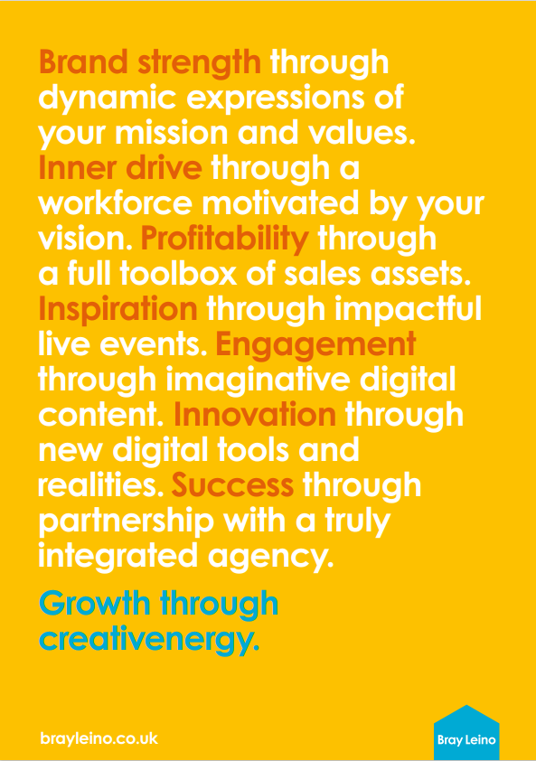
Notes:
Technology – 17 – SaaS 10 – Software 10 – Telecoms – 7 – Manufacturing 7 – Food & Beverage 6 – Financial Services 5 – FMCG 5

Slide 84
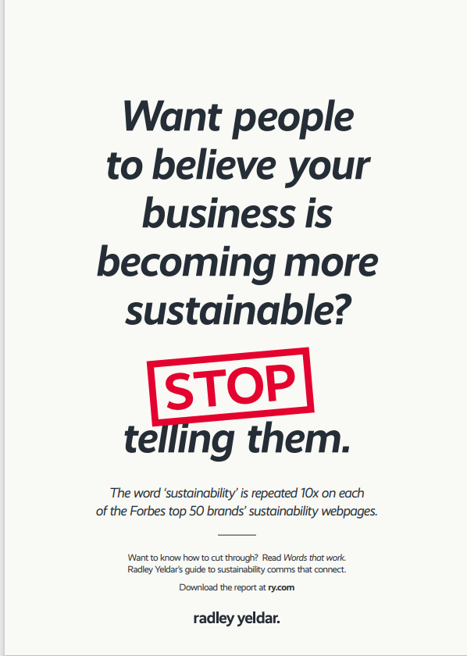

Notes:
Technology – 17 – SaaS 10 – Software 10 – Telecoms – 7 – Manufacturing 7 – Food & Beverage 6 – Financial Services 5 – FMCG 5

Slide 85
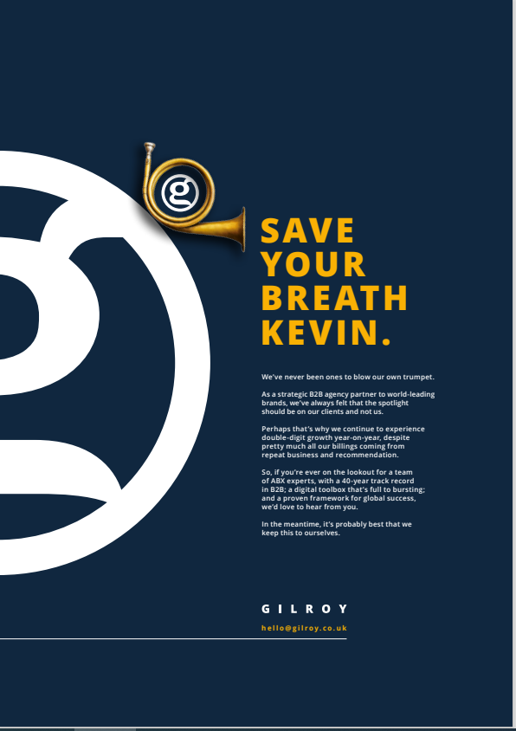
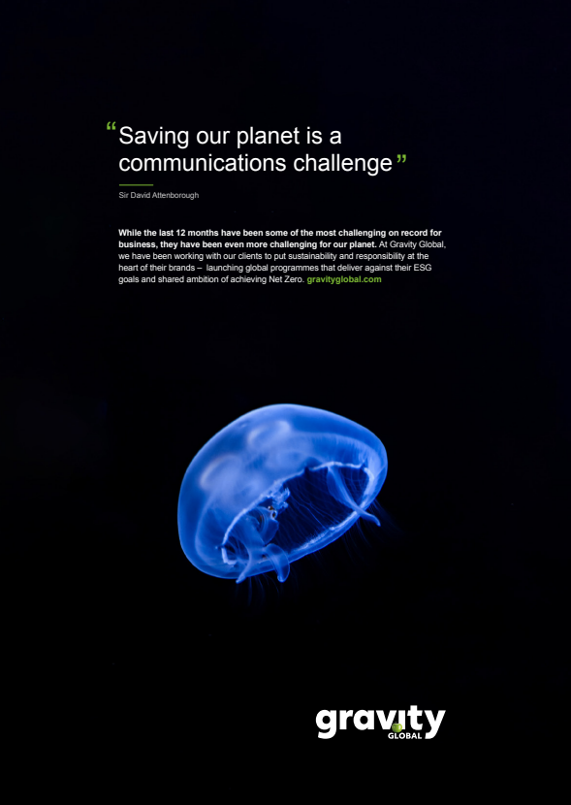
Notes:
Technology – 17 – SaaS 10 – Software 10 – Telecoms – 7 – Manufacturing 7 – Food & Beverage 6 – Financial Services 5 – FMCG 5

Slide 86
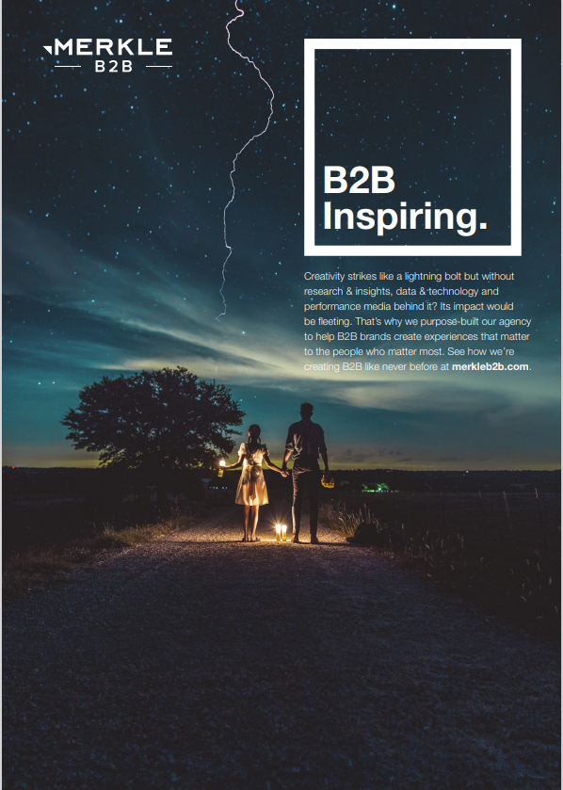
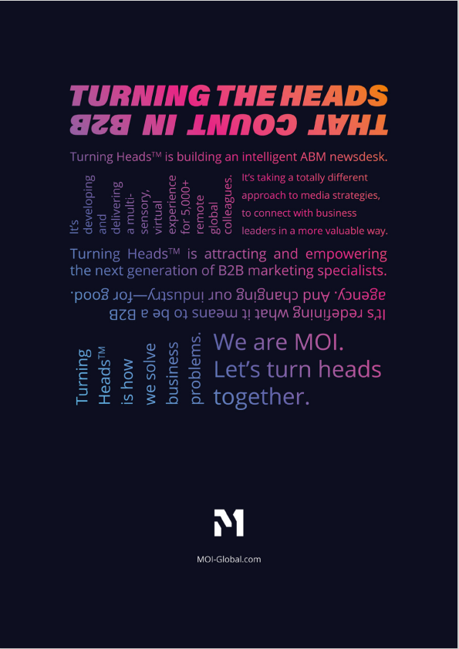
Notes:
Technology – 17 – SaaS 10 – Software 10 – Telecoms – 7 – Manufacturing 7 – Food & Beverage 6 – Financial Services 5 – FMCG 5

Slide 87
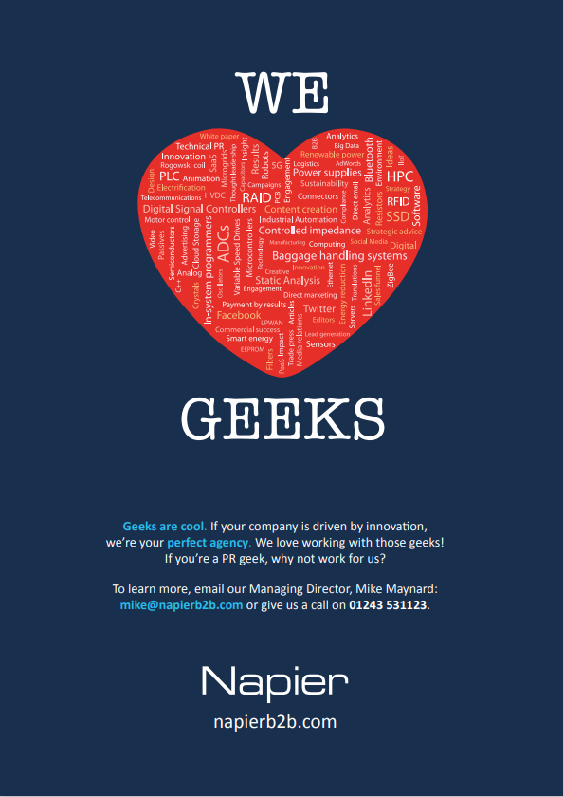
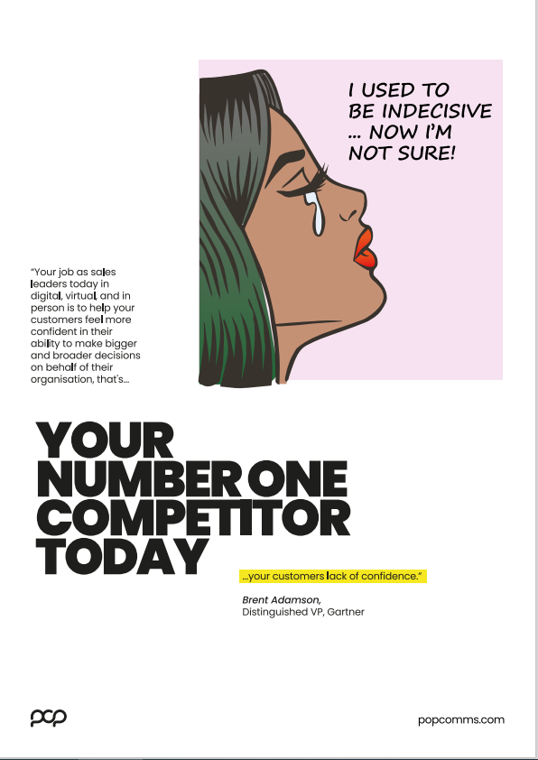
Notes:
Technology – 17 – SaaS 10 – Software 10 – Telecoms – 7 – Manufacturing 7 – Food & Beverage 6 – Financial Services 5 – FMCG 5

Slide 88
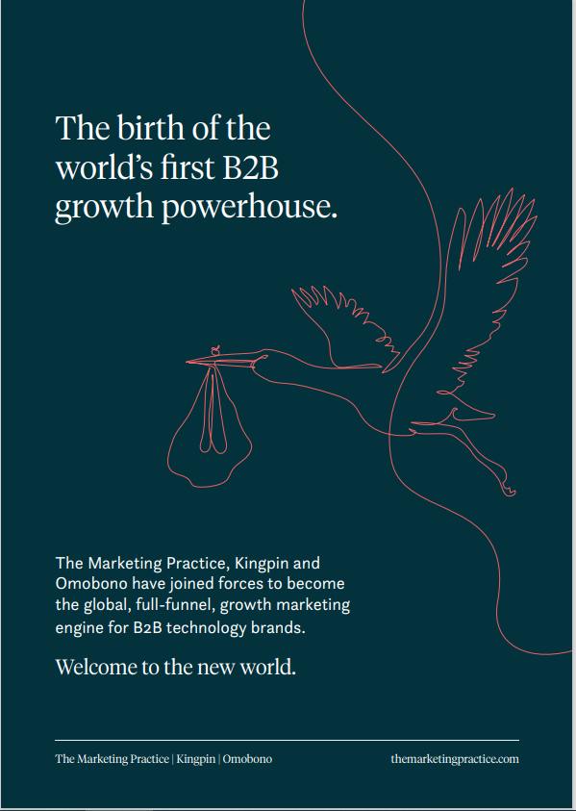

Notes:
Technology – 17 – SaaS 10 – Software 10 – Telecoms – 7 – Manufacturing 7 – Food & Beverage 6 – Financial Services 5 – FMCG 5

Slide 89
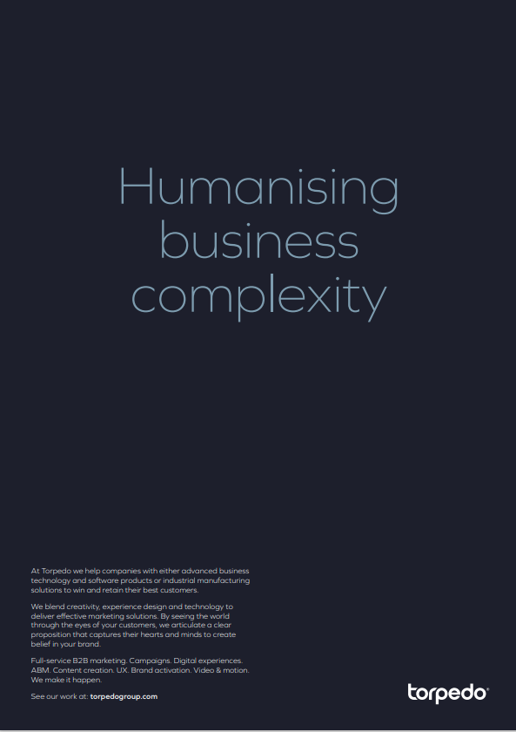

Notes:
Technology – 17 – SaaS 10 – Software 10 – Telecoms – 7 – Manufacturing 7 – Food & Beverage 6 – Financial Services 5 – FMCG 5

Slide 90
2.0 Services
2022

Slide 91
ReallyB2B Hero Service
Strategy & Research
Content & creative
Data & delivery

Slide 92
Services - What does ReallyB2B do?
Our hero services
STRATEGY & RESEARCH
CONTENT & CREATIVE
DATA & DELIVERY
Research & expert interviews
Content strategy
Data management,
insights & licensing
Audience identification,
profiling and segmentation
Big Idea
Multi-channel campaign delivery
Customer journey mapping
Copy writing & messaging
Sales enablement/enhancement
Channel strategy & planning
Content creation
Campaign management, optimisation & reporting

Slide 93
Strategy & Research
Research & expert interviews
Audience identification, profiling and segmentation
Customer journey mapping
Channel strategy & planning
You know where you are, and you know where you want to get to – but the question is, ‘how?’
Without an effective strategy, your goals and targets are merely dreams and ambitions.
ReallyB2B can help to expertly crafted a plan of action based on data and intelligent insights.
Just like using a sat nav to avoid traffic jams, with the right help and support for your B2B marketing, you can reach your goals in the most efficient way.

Slide 94
Strategy & Research
Research and
expert interviews
What do you know about your audience?
What job do they do? What are their responsibilities? How do they feel? What keeps them up at night? How do they make decisions?
Without the answers to these questions, your marketing is basically taking shots in the dark and hoping for the best. That’s why our expert researchers meticulously gather and analyse qualitative and quantitative data to inform your strategy. The outcome of this in-depth investigation is the ability to send the right message to the right person at the right time.
Consolidation of existing insights and information into clear concise formats
Desk-based conducted research into audience, industry and competitors
Quantitative surveys of key decision-makers
Recruitment and 1:1 deep-dive interviews with highly targeted experts

Slide 95
Strategy & Research
Audience identification,
profiling and
segmentation
B2B marketers has a tendency to believe that campaigns are aimed at businesses or specific job roles. But this is a risky mindset. The fact is, behind every screen and every name badge is a person – with feelings and emotions. These people have desires, wants and needs.
Your product/service isn’t just about solving their problem, it’s about how it makes them feel e.g., more confident or less stressed etc. It’s for this reason that we use emotional intelligence and empathy to not only uncover your best opportunities, but also get to know them on a deeper level and plan your marketing strategy around their innermost wishes and aspirations.
Gather accessible contact information from a range of GDPR-compliant providers
Insight review into the needs of decision-makers and how these vary
Segmentation of decision-making unit based on where their needs vary by firmographic data
Target company key contact profiling and data licensing

Slide 96
Strategy & Research
Channel strategy
and planning
Having analysed your audience to identify the best prospects, and investigated their drivers, desires and wants, the question now is, how do you best connect with them? Is it email, social media, digital advertising, or a combination of them all?
At ReallyB2B, we are multi-channel solutions experts, meaning we can connect with your audience via the channels that suit them best. But we also have the capacity to identify which channels will enable you to achieve your goals most effectively.
Our in-house planning hub, Enigma 2.0, has over 14 million rows of live campaign data (such as open rates and clickthrough rates), enabling us to not only forecast results, but also create the perfect multi-channel plan in line with your buyers’ behaviours and your needs.
Cross-tab analysis of target market with our experience using Enigma 2.0
Accessibility review of key contacts by channel
Assessment of owner routes to market via events and 3rd-party publishers
Creation of clear go-to-market strategy

Slide 97
Strategy & Research
Customer journey mapping
In an ideal world, a prospect would receive your communication, call a salesperson, and convert to a customer immediately. But we know this is unlikely. In fact, in today’s world of growing decision-making groups, the likelihood is that conversion to a customer could take months (sometimes years).
For this reason, your marketing strategy requires effective mapping of touchpoints, engagements and conversion opportunities. How is your audience moved from one touchpoint to the next? How do you intend to keep them engaged and informed without scaring them off? Our experts will work with you to map out your entire customer journey plus all potential routes to ensure all opportunities are maximised.
Audit of existing customer journey and identification of pinch points
Customer journey content plan to drive conversion at each stage
Clear and candid marketing strategy to direct attention where it matters most

Slide 98
Content and Creative
You have a great product/service, and you know the audience you want to engage. But how do you make your proposition distinct in a marketplace filled with similar solutions and messages?
The answer is content and creative. This is your opportunity to create disruption, differentiate yourself from your competitors and most importantly… get your audience interested. From informative and helpful, to entertaining and engaging, content and creative is your opportunity to stand out from the crowd and make your brand memorable.
Content strategy
Big Idea
Copy writing & messaging
Content creation

Slide 99
Content and Creative
Content strategy
The internet is awash with marketing content that seems to have been produced for no reason other than blatant self-promotion. This shows a lack of strategy and planning. Whilst some may think that content is simply the creation of an infographic or ebook, it’s actually so much more than this.
Content is a tool used to not only engage an audience, but also to position the publishing brand as an industry thought leader. It requires data analyses, planning, strategy and above all else, expertise. At ReallyB2B, our specialists work with you to create a content strategy that not only serves your purpose, but also deeply connects with your audience.
.
Analysis of qualitative and quantitative research findings
Investigation of pain points and industry news
Identification of key messages and potential solutions
Schedule of content based on audience appetite and campaign plan
Synopses of each content piece

Slide 100
Content and Creative
Big idea
A big idea is a campaign look and feel that develops elements of your existing brand guidelines (such as graphic styles and tone of voice) to create a new high-impact and engaging aesthetic, which will be used across all elements of your campaign.
Based on factors such as competitor analyses and the need for marketplace disruption, a big idea is the all-encompassing structure that not only makes you stand out from the crowd, but engages your audience. From communications to events, the big idea enables you to elevate all of your activities for the length of the campaign, without the need to rebrand your business.
Initial research and competitor analysis
Presentation of a range of campaign big ideas
Development of chosen routes and visuals
Final presentation of tactical examples to show the ‘campaign in action’

Slide 101
Content and Creative
Copywriting and messaging
When marketing your product/service to
your target audience, it’s vitally important that everyone
from writers to salespeople, have a unified and consistent message. Without this, your brand and your proposition can quickly become diluted and less memorable.
It’s for this reason that our experts will create a messaging hierarchy to be used within your communications and wider business – which ensures a cohesive and aligned response to all your prospects, and in reply to all their pain points.
What’s more, our specialist writers will ensure your proposition is presented in such a way that it not only generates engagement but also creatively ignites conversations with your audience.
Deep investigation into product/solution
Development of product features into audience benefits
Pain point identification and response generation
Addition of supplementary proof points

Slide 102
Content and Creative
Content creation
Even with a comprehensive content plan and
messaging hierarchy, the creation of actual content
is not something to be attempted by just anyone.
Writing a piece of content requires an expert eye, the drive
of an investigative journalist and the writing abilities of a veteran
novelist.
Why? Because not only does content need to engage the audience and provide them with helpful advice and guidance, but with the right approach it also does wonders for brand positioning. A well-written ebook or tip sheet can make the reader think ‘this company really knows what they are talking about, they are happy to share their knowledge with me, they seem to be trustworthy, and I should definitely speak to them when I’m shortlisting suppliers. Good content isn’t just for your readers, it’s also a priceless tool in making your brand an industry leader.
Research into potential solutions
Creation of overarching narrative with key points identified
Initial draft crafted from content synopses
Design and creation in suitable format
Final developments and production
Formats including (but not limited to): Infographics, tip sheets, case studies, ebooks, videos (long and short form), webinar packages, digital assets

Slide 103
Data and Delivery
Data management, insights & licensing
Multi-channel campaign delivery
Sales enablement/enhancement
Campaign management, optimisation & reporting
Effectively delivering, managing and optimising a successful B2B marketing campaign takes time, resources and a vast skillset. The likelihood is that you already have many of these assets at your business, but with success and business growth comes additional needs and pressures – so let us help.
At ReallyB2B, our experts passionately support and empower your team to achieve their goals. We bring the experience and knowledge needed to seamlessly integrate with your people and help you reach your targets.

Slide 104
Data and Delivery
Data management, insights & licensing
Data is the lifeblood of any marketing campaign. But, in its rawest form it’s simply information and numbers. In order to unlock its true value and turn it into a key differentiator, you need specialists to not only manage it effectively, but also mine it for its priceless insights. You see, data is not the end goal. Your objective should be to uncover the trends, correlations, and predictions hidden within it.
At ReallyB2B, our experts can not only gather and license data on behalf of clients, but also cleanse and mine it for the unseen gems.
Aggregation of accessible data from a range of GDPR-compliant providers
Intent data of companies researching products right now
Data licensing, cleansing and activation into campaigns
Ongoing management of data and strategic recommendations

Slide 105
Data and Delivery
Multi-channel
campaign delivery
As the name suggests, a multi-channel campaign involves a variety of activities, from email distribution to media purchasing. Whilst each job requires a certain degree of knowledge and experience, when the campaign is viewed holistically, it can become an overwhelming prospect. That’s why it’s vitally important to understand the benefits that come from working with experts.
From data projects and research activity, to multi-channel distribution and account based marketing (ABM), partnering with specialists ensures you can confidently relax in the knowledge that your marketing is being carried out in the best possible way by proven marketers.
Campaign setup and builds across email and digital platforms
Marketing automation strategy, builds and management
3rd-party management and activation i.e. LinkedIn
Database management ensuring one clear and consistent view

Slide 106
Data and Delivery
Sales enablement / enhancement
What good is generating hot leads if your salespeople have no idea what the aligned campaign messaging is, and what path the leads took to arrive at an exploratory call? This is why marketing activity must include sales enablement and empowerment packs.
At ReallyB2B, we work with our clients to create everything from battlecards to individual account analyses (for use with ABM). This ensures that when salespeople finally speak to leads, they are fully aware, fully informed, and fully capable of turning that lead into a new customer.
LinkedIn profile and networking supercharge
Key account sales packs detailing key information and clear activation plan by target
Sales collateral audit, recommendations and formation of new assets
Alignment of sales/marketing processes to ensure maximum campaign efficiency

Slide 107
Data and Delivery
Campaign management, optimisation
& reporting
Due to the sheer amount of time and energy that goes in to planning an effective marketing strategy, it can feel counterintuitive to change this once the campaign is underway. But, this agility is a key differentiator.
Part of what makes us experts at ReallyB2B is our laser focus on the numbers. We carefully watch campaign data for any tell-tale trends or reactions and adjust campaign plans accordingly. This ability to recognise opportunities and optimise campaigns in accordance, is the difference between success and failure.
Dedicated account management team
Campaign deployment and management across all appropriate channels
Centralised reporting and response handling
Clear recommendations for iterations and ongoing improvements

